Slide 1
Today and Tomorrow:
Integrating Oral SERDs, PROTACS, Biomarkers, and Sequencing in ER+/HER2− mBC Care

Slide 2
DISCLAIMER
This slide deck in its original and unaltered format is for educational purposes and is current as of September 2026. All materials contained herein reflect the views of the faculty, and not those of AXIS Medical Education, the CME provider, or the commercial supporter. Participants have an implied responsibility to use the newly acquired information to enhance patient outcomes and their own professional development. The information presented in this activity is not meant to serve as a guideline for patient management. Any procedures, medications, or other courses of diagnosis or treatment discussed or suggested in this activity should not be used by clinicians without evaluation of their patients’conditions and possible contraindications and/or dangers in use, review of any applicable manufacturer’s product information, and comparison with recommendations of other authorities.

Slide 3
DISCLOSURE OF UNLABELED USE
This activity may contain discussion of published and/or investigational uses of agents that are not indicated by the FDA. The planners of this activity do not recommend the use of any agent outside of the labeled indications.
The opinions expressed in the activity are those of the faculty and do not necessarily represent the views of the planners. Please refer to the official prescribing information for each product for discussion of approved indications, contraindications, and warnings.
USAGE RIGHTS
This slide deck is provided for educational purposes and individual slides may be
used for personal, non-commercial presentations only if the content and references
remain unchanged. No part of this slide deck may be published in print or
electronically as a promotional or certified educational activity without prior written
permission from AXIS. Additional terms may apply. See Terms of Service on
www.axismeded.com for details.

Slide 4
Learning Objectives
Upon completion of this activity, participants should be better able to:
Compare emerging efficacy and safety data for oral SERDs, including PROTACs and novel combinations, to inform evidence-based clinical decisions in ER+/HER2- mBC
Assess current considerations for treatment selection in ER+/HER2- mBC, including the use of oral SERDs and PROTACs in patients with prior ET and CDK4/6 inhibitor exposure
Evaluate clinical strategies that take ESR1 mutations into account when sequencing oral SERDs, including PROTACs and other targeted therapies, in ER+/HER2− mBC
Describe interdisciplinary strategies for monitoring and managing AEs associated with oral SERDs and PROTACs in the treatment of ER+/HER2- mBC

Slide 5
TODAY: Oral SERDs and PROTACs – Testing Smarter, Treating Better in ER+/HER2− mBC
Treatment Selection Post-AI ± CDK4/6i Now: Role for ESR1 Testing

Slide 6
Evolving Treatment Landscape of HR+/HER2− MBC
Novel SERD
Novel SERD
PI3K inhibitor
Imlunestrant
Camizestrant + CDK4/6i
  Selective ER
  Degrader (SERD)
HER2-targeting ADC
Novel SERD
CDK4/6 inhibitors
PROTAC
Novel SERD
Fulvestrant,
Fulvestrant HD
Palbociclib, ribociclib, abemaciclib
Trastuzumab deruxtecan
Elacestrant
Inavolisib + Fulvestrant + Palbociclib
Vepdegestrant
Imlunestrant + abemaciclib
1970-
2000
2000-2010
2012
2015-2018
2019-2020
2022
2023
2024
2025
2026
Selective ER modulator and AIs
mTOR inhibitor
PARP inhibitors
PIK3CA inhibitor
TROP2-targeting ADC
AKT inhibitor
HER2-targeting ADC
PI3K/AKT/
mTOR
inhibitor
Tamoxifen, anastrozole, exemestane, letrozole
Everolimus
Talazoparib, olaparib
Alpelisib
Sacituzumab govitecan
Capivasertib
Trastuzumab deruxtecan*
Gedatolisib + Fulvestrant ±
Palbociclib
IO
NTRK inhibitors
RET inhibitors
TROP-2 ADC
Datopotamab
Pembrolizumab
Entrectinib
Larotrectinib
Selpercatinib
Notes:
We have appreciated for a number of years that a one-size-fits-all approach does not apply necessarily to breast cancer. And so we're very grateful that we have multiple options. May it be aromatase inhibitors, may it be CDK4/6 inhibitors, and now novel endocrine agents.
So we now have three oral SERDs, elacestrant, imlunestrant, and camizestrant approved in MBC, and we have vepdegestrant, a PROTAC. Elacestrant, imlunestrant and vepdegestrant are approved as monotherapy for ESR1 mutant tumors, and we use them upon progression of a CDK4/6 inhibitor. So you have an ESR1 mutation, we have an effective drug that targets this resistance mechanism.
Camizestrant is approved in combination with a CDK4/6 inhibitor upon detection of ESR1 mutation during AI + CDK4/6i therapy in the first-line.
And, imlunestrant is also now approved in combination with abemaciclib, a CDK 4/6 inhibitor, after disease progression following at least one line of endocrine therapy, so continuing a CDK4/6 beyond progression.

Slide 7
Overall Survival in Patients Treated With CDK4/6i for Metastatic Disease: Non–Head-to-Head Comparison
 | Treatment arm: OS, median, mo | Placebo arm: OS, median, mo | Hazard ratio | Hazard ratio (95% CI) | P value | Significance reached vs placeboª
PALOMA-2¹ Palbociclib + letrozole | 53.9 | 51.2 |  | 0.956 (0.777-1.177) | 0.3378 | ✗
PALOMA-3² Palbociclib + fulvestrant | 34.9 | 28.0 |  | 0.81 (0.64-1.03) | .09 | ✗
MONARCH 2³ Abemaciclib + fulvestrant | 46.7 | 37.3 |  | 0.76 (0.61-0.95) | .01 | ✓
MONARCH 3 Abemaciclib + NSAI | 66.8 | 53.7 |  | 0.804 (0.637-1.015) | .0664 | ✗
MONALEESA-2^{4,5} Ribociclib + letrozole | 63.9 | 51.4 |  | 0.76 (0.63-0.93) | .004 | ✓
MONALEESA-7⁶ Ribociclib + goserelin + tamoxifen/NSAI | NR | 40.9 |  | 0.71 (0.54-0.95) | .00973 | ✓
MONALEESA-3⁷ Ribociclilb + fulvestrant | NR | 40.0 |  | 0.72 (0.57-0.92) | .00455 | ✓
PAL
ABE
RIBO
0.4
0.6
0.8
1.0
1.2
Favors CDK4/6i
Favors PBO
Notes:
CDK4/6 inhibitors, when combined with ET, have become a standard of care (SOC), demonstrating significant improvements in progression-free survival (PFS) and overall survival (OS) for patients with mBC compared to ET alone.

Slide 8
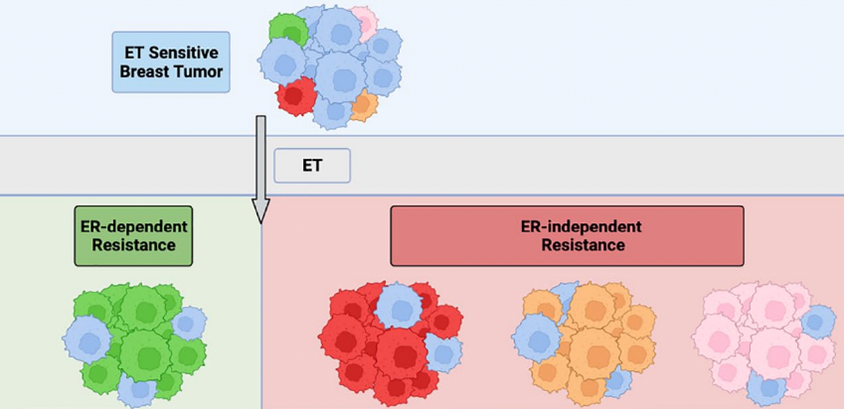
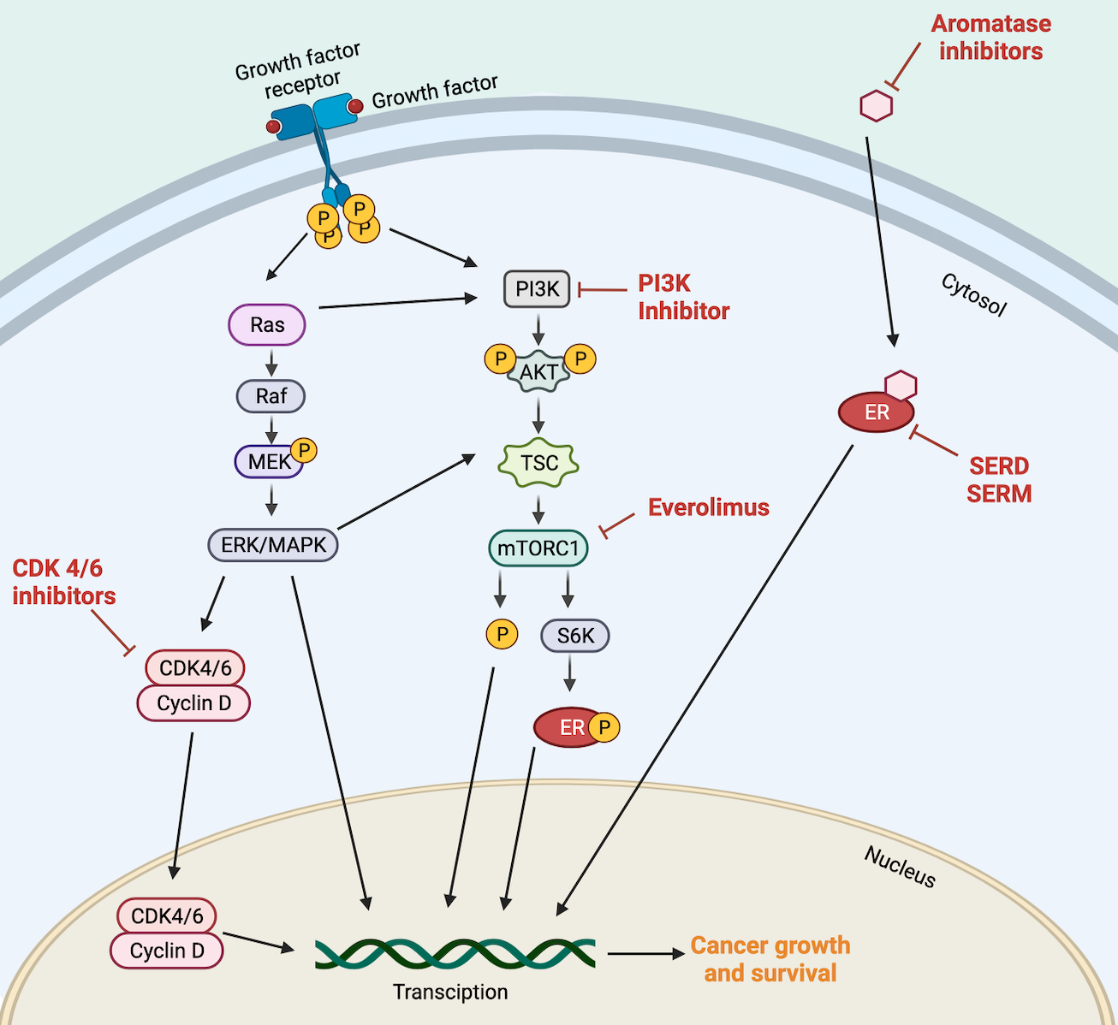

Background: Resistance to ET + CDK4/6i
ER-dependent and -independent mechanisms of resistance
ET Sensitive Breast Tumor
ET
ER-dependent Resistance
ER-independent Resistance
AKT inhibitor
mTOR inhibitor
ESR1 Mutation
GF RTK Alteration
MAPK Pathway Alteration
PI3K/AKT Pathway Upregulation
Constitutive
ER activity
Upregulated
coactivator binding
Stability against proteolytic
degradation
Growth factor-driver receptor tyrosine kinase
HER2
EGFR
FGFR
Alterations in MAPK
KRAS
BRAF
MAP2K1
NF1
Upregulation PIK3K/AKT
PIK3CA
PTEN
AKT
~40% have PIK3Ca/AKT/PTEN mutations
~40% have an emergence of ESR1 mutations
Notes:
However, treatment options for mBC after progression on first-line therapy remain limited, highlighting a critical unmet need. Resistance to ET presents a major obstacle in managing ER+/HER2- mBC, emphasizing the urgent need for novel therapies that can overcome resistance and enhance patient outcomes.

Slide 9
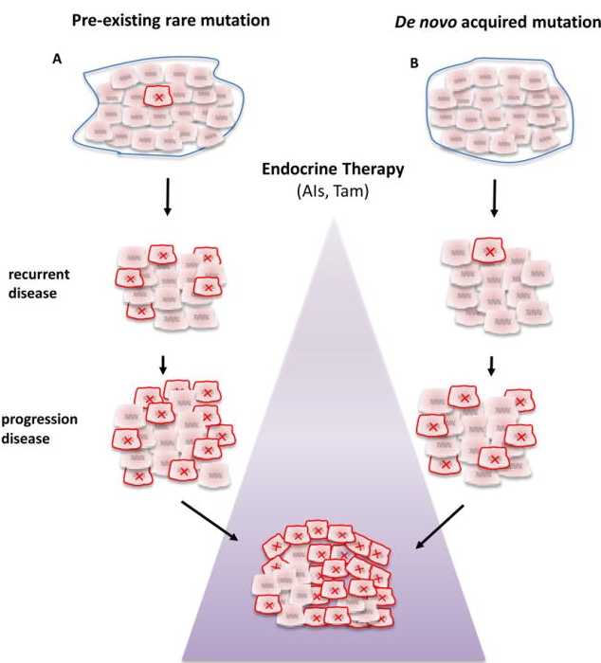
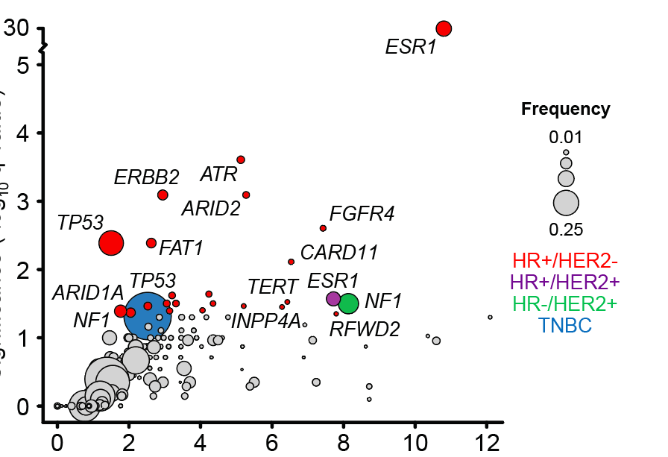
Acquired ESR1 Mutations
Clonal Selection Scenarios
Existing ESR1 mutations: ~1%
Primary ER+ breast cancer
Preexisting rare mutation
De novo acquired mutation
Acquired ESR1 mutations: 10% to 50%
Endocrine therapy
(AIs, Tam)
Recurrent disease
Metastatic ER+ breast cancer
Progressive disease
Significance (-log₁₀ q-value)
Odds ratio
Notes:
Although ET remains the main treatment for ER+/HER2- mBC, resistance is almost inevitable and presents a major challenge in long-term disease management. A common mechanism of secondary resistance, especially after aromatase inhibitor therapy, involves mutations in ESR1.
Mutations in the ligand-binding domain of the estrogen receptor (ESR1) are frequently seen in mBC, especially in patients who have been treated with ETs like aromatase inhibitors. Therapeutic resistance can arise from mutations in ESR1 that promote estrogen-independent transcription and tumor cell proliferation.

Slide 10
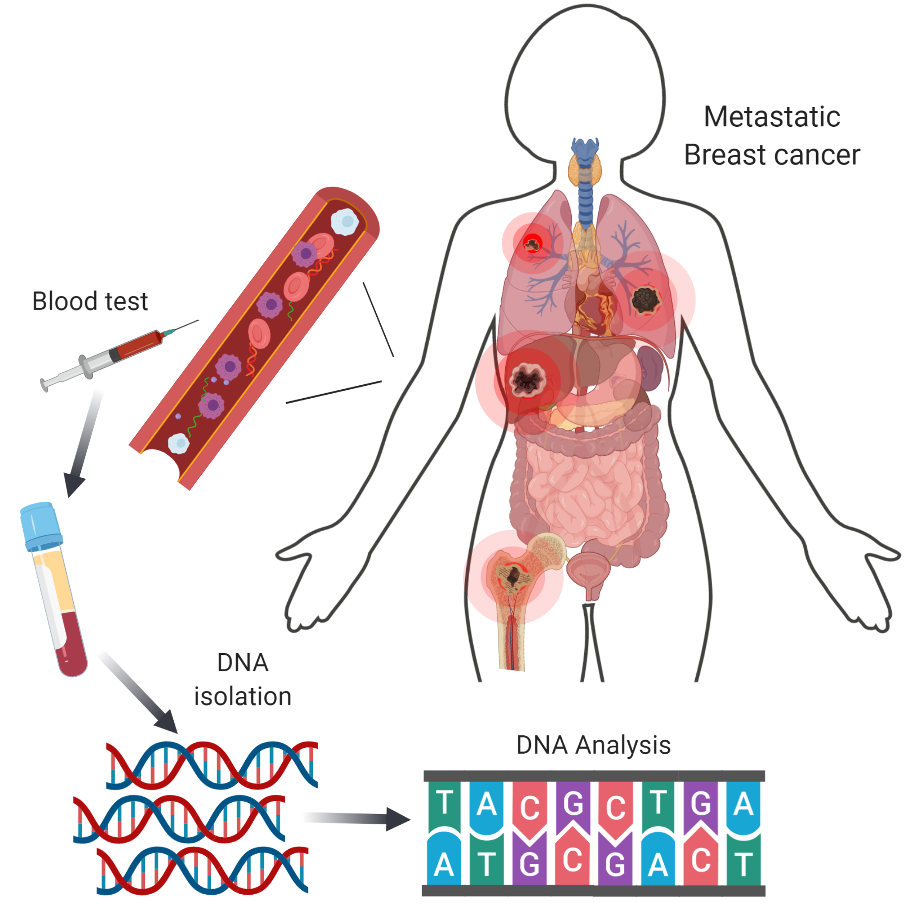
ESR1 Mutations Are Subclinical: Liquid Biopsy Testing is the Standard
ctDNA testing identified more ESR1 mutations than contemporaneous biopsy
Different metastases may develop different resistance mutations
Contemporaneous Paired Samples
100
91.2
100
100
100
57.9
88.9
96.7
100
Concordant Negative
75
Concordant Positive
Discordant: Tissue Positive, dPCR Negative
Discordant: Tissue Negative, dPCR Positive
50
25
0
AKT1
n = 39
HER2
n = 39
ESR1
n = 39
PIK3CA
n = 39
dPCR vs Tissue Sequencing
Binary Status Agreement
Notes:
Studies have shown that patients with ER+/HER2- mBC and detectable ESR1 mutations have better outcomes when treated with new oral SERDs. Detecting these mutations is more effectively done through liquid biopsy techniques, especially ctDNA analysis, which provides a sensitive, non-invasive alternative to traditional tissue biopsies. This is particularly important because ESR1 mutations are often subclonal and may not be consistently detected using tissue-based methods.

Slide 11
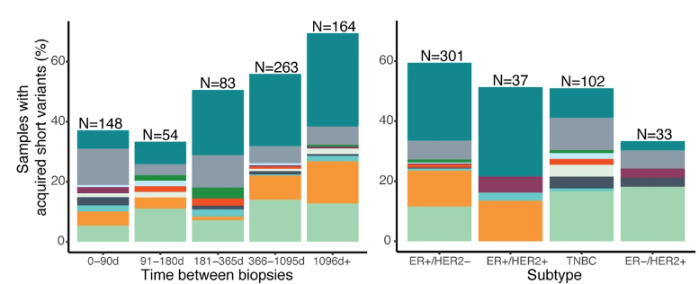
ESR1 Mutations: Rate of Acquisition and Prevalence
ESR1m increase over time
ESR1 Mutation Prevalence in ctDNA
Trial | Study Population | ER+ MBC Patient Population | ESR1 Mut, %
MONALEESA-2¹ | Letrozole ± ribociclib | 1st line | 4.0
BOLERO-2² | Exemestane ± everolimus | After PD on ET | 28.8
FERGI³ | Fulvestrant ± pictilisib | After PD on ET | ~40.0
PALOMA-3⁴ | Fulvestrant ± palbociclib | After PD on ET | 25.3
SOFeA⁵ | Fulvestrant ± anastrozole | After PD on ET | 39.1
60
60
40
40
Samples with acquired short variants (%)
20
20
0
0
0-90d
91-180d
181-365d
366-1095d
1096d+
ER+/HER2–
ER+/HER2+
TNBC
ER–/HER2+
Time between biopsies
Subtype
Gene
*ATM, CHEK2, JAK2 assessed separately only for Panel A

Slide 12
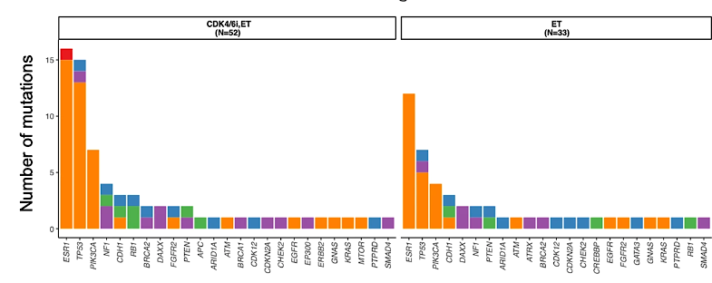

ESR1m More Prevalent After CDK4/6i
ESR1 alteration prevalence post–AI
ESR1 alteration prevalence post–AI+CDK4/6i
<1yr
(n=41)
<1yr
(n=51)
1-2yrs
(n=25)
1-2yrs
(n=32)
1L duration
1L duration
>2yr
(n=39)
>2yr
(n=26)
0
20
40
60
0
20
40
60
Median prevalence post–treatment (%)

Slide 13
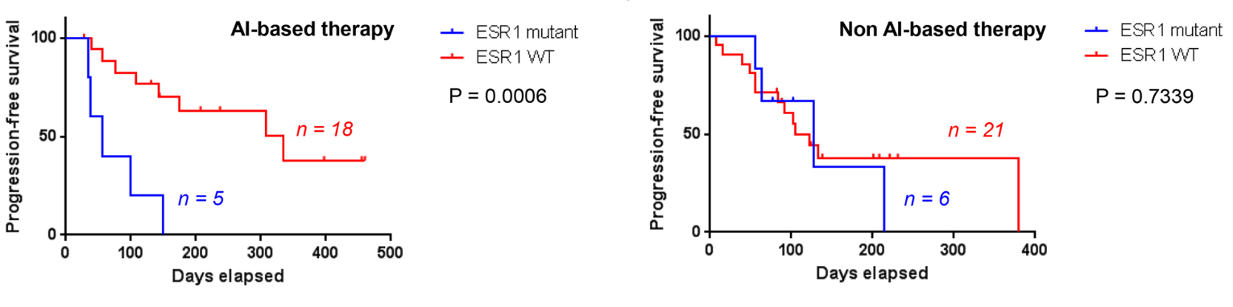
ESR1m Are Associated With Poorer Prognosis in Patients With MBC Who Progressed on 1L Treatment
PFS of Patients Who Received AI vs
Other Therapies as Subsequent Therapy¹
    Median PFS in Patients With ESR1mut Who Progressed on ET Compared With Patients With ESR1wt
 | PALOMA-3 2L fulvestrant² | SoFEA & EFECT 2L exemestane³ | BOLERO-2 2L everolimus⁴
ESR1mut patients | 3.6 mo | 2.4 mo | 5.8 mo
ESR1wt patients | 5.4 mo | 4.8 mo | 8.5 mo
The presence of ESR1mut in patients with MBC who progressed on 1L therapy, in studies testing ESR1mut
either retrospectively or prospectively, was associated with reduced survival and response to ET¹⁻⁵

Slide 14
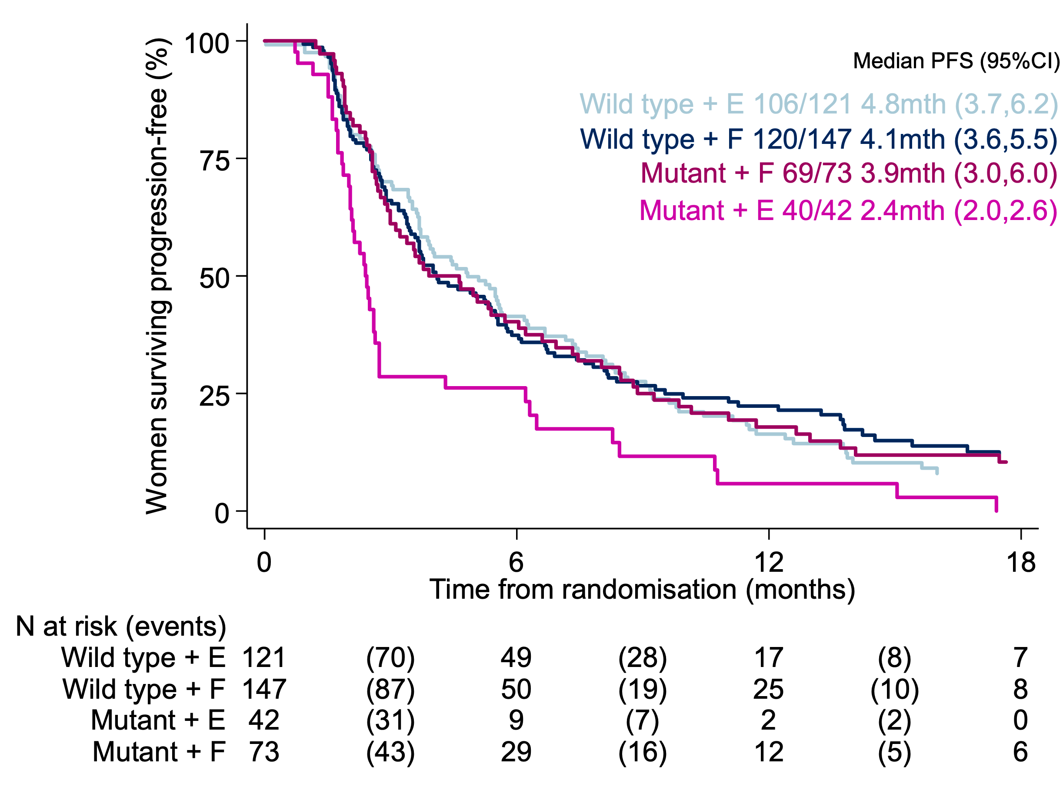
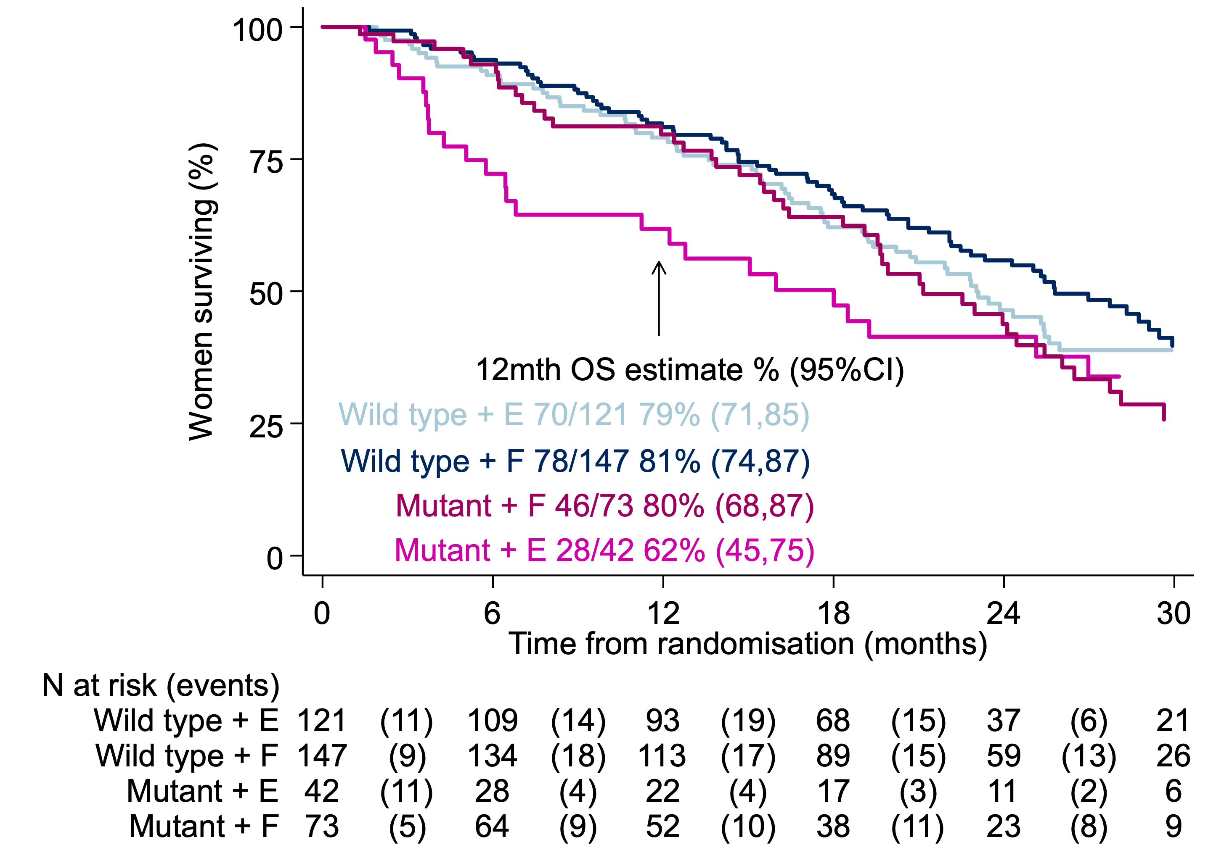
ESR1 Mutations: Predictive Implications of SoFEA and EFECT Combined Analysis
ESR1-mutant breast cancer has poor outcomes if treated with further AI
ESR1 mutations detected in 30% (151/383) of baseline samples

Slide 15
Overview of International Therapeutic Guidelines and Recommendations on ESR1-mut Testing
ASCO¹
ESMO²
NCCN³
Eligible patient population | • HR-positive / HER2-negative • On endocrine therapy (given with or without CDK4/6i) | • HR-positive / HER2-negative | • HR-positive / HER2-negative • Prior lines of endocrine therapy
Timepoint of sample collection | At progression, as ESR1-mut develop in response to selection pressure during treatment and are typically undetectable in the primary tumor | • After progression to endocrine therapy in the metastatic setting, after first line of treatment⁴ | • At progression following prior lines of endocrine therapy
Sample type | Blood or tissue BUT blood-based ctDNA preferred (owing to greater sensitivity) | • Tumor • Plasma | • ctDNA preferred
Test methodology | • CLIA-certified assay | • NGS preferred | • NGS • dPCR
Re-testing if initial result negative | • Patients whose tumor or ctDNA tests remain ESR1-mut wild-type may warrant retesting at subsequent disease progression(s) to determine if an ESR1-mut has arisen | • Not specifically mentioned | • Not specifically mentioned
Notes:
As the disease progresses after ET, choosing the best next treatment becomes more complicated. Molecular profiling is key in guiding treatment choices, and biomarker testing, including screening for ESR1 mutations, is now recommended at recurrence or progression on ET in patients with ER+/HER2 mBC.
Recognizing the clinical significance of ESR1 testing, major clinical guidelines, including those from the National Comprehensive Cancer Network (NCCN), American Society of Clinical Oncology (ASCO), and European Society for Medical Oncology (ESMO), recommend ESR1 mutation assessment at disease progression after ET, preferably using ctDNA.

Slide 16
TODAY: Oral SERDs and PROTACs – Testing Smarter, Treating Better in ER+/HER2− mBC
Evidence Review: How Oral SERDs and PROTAC Degraders Address Shortcomings of IM Fulvestrant

Slide 17
Limitations of Currently Approved Endocrine Therapies
Tamoxifen
Aromatase Inhibitors
Fulvestrant
  Partial ER agonist, blocks AF2 but allows activation of AF1
  Manifests as weaker ER suppression
  Toxicity profile
  Acquired ESR1 mutations
  Confer AF2 activity in the absence of estrogen
  Toxicity profile
  Inconvenience: IM injection
  Poor PK
  Efficacy is dose dependent/incomplete ER degradation
  Single-agent activity limited post-CDK4/6 inhibitors
  Activity limited in ESR1 Y537S
Nonadherence is an issue in early stage due to toxicity:
49% fully adherent with 5 years of ET
McDonnell DP, et al. J Clin Oncol. 2021;39(12):1383-1388. Lindeman GJ, et al. ASCO 2021. Abstract 1004. Toy W, et al. Cancer Discov. 2017;7(3):277-287.
Hershman DL, et al. J Clin Oncol. 2010;28(27):4120-4128.
Notes:
We have fulvestrant as our SERD that is available in clinic. But we know that these have their own limitations. For instance, under the acquired pressure and selective pressure of aromatase inhibitors, there is emergence of ESR1 mutations, which leads to ligand-independent yet ER-dependent growth of the pathway and tumor growth. Similarly, with fulvestrant, while it's an estrogen receptor degrader, it has its own limitations, not limited to just its pharmacokinetic abilities – there is lack of oral bioavailability given it's an intramuscular injection – but we've also seen that its activity is rather modest upon progression on a CDK4/6 inhibitor in the metastatic setting. Certainly a burden for the patients to come in to the infusion center to get their injections. And the activity is certainly limited for certain ESR1 mutations, namely the Y537S.

Slide 18
Approved Novel Endocrine Therapies:
Oral SERDs and PROTACs
 | SERD |  |  | PROTAC
Therapy | Elacestrant | Imlunestrant | Camizestrant | Vepdegestrant
Trial | EMERALD | EMBER-3 | SERENA-6 | VERITAC-2
FDA Approval Date | January 2023 | September 2025 September 2026 | September 2026 | May 2026
FDA Approved Indication | Postmenopausal women or adult men, with ER+, HER2-, ESR1-mutated advanced or MBC with disease progression following at least one line of endocrine therapy | Adults with ER+, HER2-, ESR1-mutated advanced or MBC with disease progression following at least one line of endocrine therapy In combination with abemaciclib, for adults with ER+, HER2-, ESR1-mutated advanced or MBC, as detected by an FDA-authorized test, with disease progression following at least one line of endocrine therapy | In combination with a CDK4/6i for adults with HR+, HER2- locally advanced or MBC upon detection of ESR1 mutation during AI + CDK4/6i therapy | Adults with ER-positive, HER2-negative, ESR1-mutated advanced or MBC, as detected by an FDA-authorized test, with disease progression following at least one line of endocrine therapy
As of September 2026.
FDA.gov. https://www.fda.gov/drugs/resources-information-approved-drugs/fda-approves-elacestrant-er-positive-her2-negative-esr1-mutated-advanced-or-metastatic-breast-cancer.
FDA.gov. https://www.fda.gov/drugs/resources-information-approved-drugs/fda-approves-imlunestrant-er-positive-her2-negative-esr1-mutated-advanced-or-metastatic-breast.
FDA.gov. https://www.fda.gov/drugs/resources-information-approved-drugs/fda-grants-accelerated-approval-camizestrant-cdk46-inhibitor-esr1-mutated-hr-positive-her2-negative.
FDA.gov. https://www.fda.gov/drugs/resources-information-approved-drugs/fda-approves-vepdegestrant-er-positive-her2-negative-esr1-mutated-advanced-or-metastatic-breast.
FDA.gov. https://www.fda.gov/drugs/resources-information-approved-drugs/fda-approves-imlunestrant-combination-abemaciclib-er-positive-her2-negative-esr1-mutated-advanced-or.
Notes:
Hence, these newer novel endocrine agents such as oral SERDs, PROTACs, CDERs, novel SERMs are very, very attractive because they are able to overcome these pharmacologic liabilities, these resistance mechanisms and more. These are oral drugs.
And we now have had approval for three oral SERDs, elacestrant, imlunestrant, and camizestrant, based on the phase 3 EMERALD, EMBER-3, and SERENA-6 trials respectively. We had elacestrant approved back in January of 2023. Imlunestrant was approved initially in September 2025 and then in combination with abemaciclib in September 2026. Camizestrant was also approved in September 2026 in combination with a CDK4/6 inhibitor in the first-line setting. And then earlier this year in May 2026, we also had approval for our PROTAC, a proteolysis targeting chimera, vepdegestrant, based on the phase 3 VERITAC-2 study.

Slide 19
EMERALD Phase 3 Study Design
Inclusion Criteria
Men and postmenopausal women with advanced/metastatic breast cancer
ER-positive,ª HER2-negative
Progressed or relapsed on or after 1 or 2 lines of endocrine therapy for advanced disease, one of which was given in combination with a CDK4/6i
≤1 line of chemotherapy for advanced disease
ECOG PS 0 or 1
Elacestrant
400 mg daily^{c}
PD or withdrawal criterion^{d}
Two Primary Endpoints:^{e}
PFS in all pts
PFS in ESR1-mut
R
Follow Up
1:1^{b}
Investigator’s choice (SOC):
Fulvestrant
Anastrozole
Letrozole
Exemestane
Stratification Factors:
ESR1-mutation status^{f}
Prior treatment with fulvestrant
Presence of visceral metastases
ªDocumentation of ER+ tumor with ≥ 1% staining by immunohistochemistry. ^{b}Recruitment from February 2019 to October 2020. ^{c}Protocol-defined dose reductions permitted. ^{d}Restaging CT scans every 8 weeks. ^{e}Blinded Independent Central Review. ^{f}ESR1-mutation status was determined by ctDNA analysis using the Guardant360 assay (Guardant Health, Redwood City, CA).
Notes:
This randomized, open-label, phase III trial enrolled patients with ER-positive/HER2-negative advanced breast cancer who had one-two lines of endocrine therapy, required pretreatment with a cyclin-dependent kinase 4/6 inhibitor, and ≤ 1 chemotherapy. Patients were randomly assigned to elacestrant 400 mg orally once daily or standard-of-care (SOC) endocrine monotherapy. Primary end points were progression-free survival (PFS) by blinded independent central review in all patients and patients with detectable ESR1 mutations.
Patients were randomly assigned to elacestrant (n = 239) or SOC (n = 238). ESR1 mutation was detected in 47.8% of patients, and 43.4% received two prior endocrine therapies.

Slide 20
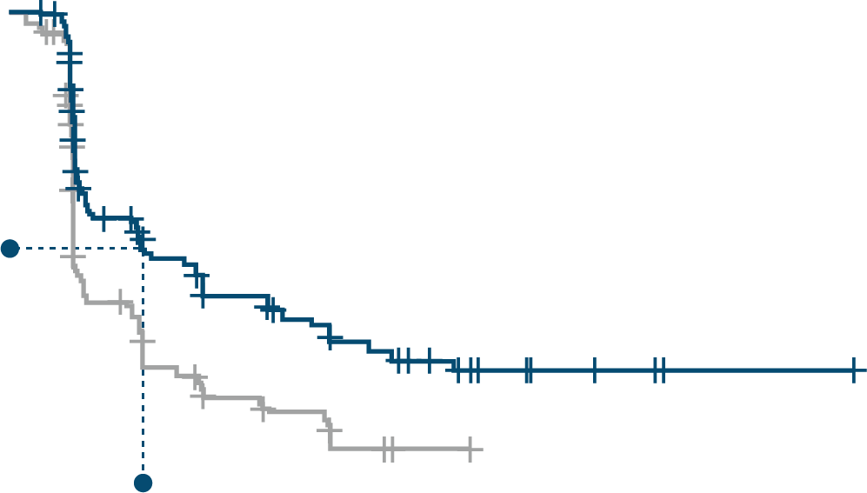
EMERALD Clinical Study Showed Statistically Significant Results for Both
ESR1-mut and ITT Patient Populations
100
ESR1-mut patient population
ITT patient population
Elacestrant SOC
100
90
80
70
60
50
40
30
20
10
0
No. of patients
Elacestrant SOC
80
PFS (%)
60
45% reduction in risk of progression or death¹
PFS (%)
40
20
0
No. of 0
patients
2
4
6
8 10 12 14 16 18 20 22 24
Months
0 1 2 3 4 5 6 7 8 9 10 11 12 13 14 15 16 17 18 19 20 21 22 23 24 25
Months
Ela | 115 105 54 46 | 35 33 | 26 26 | 21 20 | 16 14 11 9 | 7 5 | 5 | 4 | 4 | 1 | 1 1 | 1 | 1 | 0 | Ela | 239 223 106 89 | 60 | 57 | 42 | 40 | 34 | 33 | 27 | 24 19 13 11 | 8 | 7 | 6 6 2 | 2 | 2 | 2 | 1 | 0
SOC | 113 99 39 34 | 19 18 | 12 12 | 9 9 | 4 1 1 1 | 0 |  |  |  |  |  |  |  |  | SOC | 238 206 84 68 | 39 | 38 | 25 | 25 | 16 | 15 | 7 | 4 3 3 2 | 2 | 1 | 0
Elacestrant
(n=115)
SOC
(n=113)
Elacestrant
(n=239)
SOC
(n=238)
mPFS, mo
3.8 1.9
mPFS, mo
2.8 1.9
Absolute difference, mo
+1.9
Absolute difference, mo
+0.9
HR [95% CI]
0.55 [0.39–0.77], P=0.005
HR [95% CI]
0.70 [0.55–0.88], P=0.0018
POSITIVE
POSITIVE
Bidard FC, et al. J Clin Oncol. 2022;40(28):3246-3256.
Notes:
PFS was prolonged in all patients (hazard ratio = 0.70; 95% CI, 0.55 to 0.88; P = .002) and patients with ESR1 mutation (hazard ratio = 0.55; 95% CI, 0.39 to 0.77; P = .0005).
Treatment-related grade 3/4 adverse events occurred in 7.2% receiving elacestrant and 3.1% receiving SOC. Treatment-related adverse events leading to treatment discontinuations were 3.4% in the elacestrant arm versus 0.9% in SOC. Nausea of any grade occurred in 35.0% receiving elacestrant and 18.8% receiving SOC (grade 3/4, 2.5% and 0.9%, respectively).
Elacestrant is the first oral selective ER degrader demonstrating a significant PFS improvement versus SOC both in the overall population and in patients with ESR1 mutations with manageable safety in a phase III trial for patients with ER-positive/HER2-negative advanced breast cancer.

Slide 21
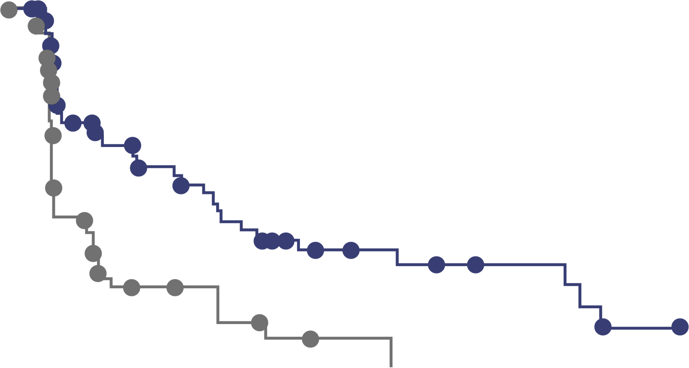
EMERALD: Duration of Prior CDK4/6 Inhibitor Therapy Is Positively Associated With mPFS in Patients With ESR1-mut*
Exploratory analyses of PFS in patients ESR1-mut tumors with ≥6,12,18 months of prior ET + CDK4/6 inhibitor
At least 6 months of prior CDK4/6i
At least 12 months of prior CDK4/6i
At least 18 months of prior CDK4/6i
100
100
100
80
Elacestrant
Standard of care
80
Elacestrant
Standard of care
80
Elacestrant
Standard of care
60
60
60
Probability of PFS (%)
Probability of PFS (%)
Probability of PFS (%)
40
40
40
20
20
20
0
0
0
0
5
10
15
20
25
30
0
5
10
15
20
25
30
0
5
10
15
20
25
30
Elacestrant
SoC
Time (months)
Elacestrant
SoC
Time (months)
Elacestrant
SoC
Time (months)
103
102
50
34
33
16
25
11
20
9
16
5
11
2
9
1
8
1
7
0
6
5
5
1
1
0
78
81
42
26
31
12
24
10
20
9
16
5
11
2
9
1
8
1
7
0
6
5
5
1
1
0
55
56
30
21
23
9
18
8
16
7
12
4
8
1
8
1
7
1
6
0
6
5
5
1
1
0
 | Elacestrant | SoC
mPFS, months (95% CI) | 4.14 (2.20–7.79) | 1.87 (1.87–3.29)
PFS rate at 12 months, % (95% CI) | 26.02 (15.12–36.92) | 6.45 (0.00–13.65)
HR (95% CI) | 0.517 (0.361–0.738)
 | Elacestrant | SoC
mPFS, months (95% CI) | 8.61 (4.14–10.84) | 1.91 (1.87–3.68)
PFS rate at 12 months, % (95% CI) | 35.81 (21.84–49.78) | 8.39 (0.00–17.66)
Hazard ratio (95% CI) | 0.410 (0.262–0.634)
 | Elacestrant | SoC
mPFS, months (95% CI) | 8.61 (5.45–16.89) | 2.10 (1.87–3.75)
PFS rate at 12 months, % (95% CI) | 35.79 (19.54–52.05) | 7.73 (0.00–20.20)
Hazard ratio (95% CI) | 0.466 (0.270–0.791)
Bardia A, et al. SABCS 2022. Abstract GS3–01.
*Post-hoc analysis results are observational in nature. There was no prespecified statistical procedure controlling for type 1 error.

Slide 22
EMBER-3 Study Design
Imlunestrant
400 mg QD
ER+, HER2- ABC
Primary Endpoints
Investigator-assessed PFS for^{f}:
A vs B in patients with ESR1m^{g}
A vs B in all patients
C vs A in all^{h} patients
A
Men and Pre-ª/Post-menopausal women
Prior therapy:
Adjuvant: Recurrence on or within 12 months of completion of AI ± CDK4/6i
ABC: Progression on first-line AI ± CDK4/6i
No other therapy for ABC
SOC ET^{d,e}
Fulvestrant or
Exemestane
R 1:1:1^{b}
N=874
B
Key Secondary Endpoints
OS, PFS by BICR, and ORR
Safety
Imlunestrant
400 mg QD +
abemaciclib^{e}
Stratification Factors:
Prior CDK4/6i therapy (Y/N)
Visceral metastases (Y/N)
Region^{c}
C^{b}
Exploratory Endpoints
PFS and OS for C vs B in all^{h} patients
Patients were enrolled from October 2021 to November 2023 across 195 sites in 22 countries.
ª A GnRH agonist was required in men and premenopausal women. ^{b} Enrollment into Arm C started with Protocol Amendment A (at which point 122 patients had been randomized across Arms A and B). ^{c} East Asia vs United States/European Union vs others. ^{d} Investigator’s choice. ^{e} Labeled dose. ^{f} Scans every 8 weeks for the first 12 months, then every 12 weeks. ^{g} ESR1m status was centrally determined in baseline plasma by the Guardant 360 ctDNA assay and OncoCompass Plus assay (Burning Rock Biotech) for patients from China. ^{h} Analysis conducted in all concurrently randomized patients.
Notes:
Patients with ER-positive, HER2-negative ABC previously treated with aromatase inhibitors ± cyclin-dependent kinase 4 and 6 inhibitors were randomly assigned (1 : 1 : 1) to receive imlunestrant, SOC, and imlunestrant—abemaciclib. Primary endpoints were PFS in imlunestrant versus SOC in patients with ESR1m and all patients, and versus imlunestrant—abemaciclib in all concurrently randomized patients. OS was a key secondary endpoint (tested if the corresponding PFS was statistically significant). Due to only two of three PFS endpoints being met, a limited significance level was passed to the OS comparisons. Exploratory endpoints included time to chemotherapy, chemotherapy-free survival, and PFS2.
A total of 874 patients were randomized (imlunestrant, n = 331; SOC, n = 330; imlunestrant—abemaciclib, n = 213). Median follow-up was 28.5 months; 10.1% of patients remained on treatment (data cut-off: 18 August 2025).

Slide 23
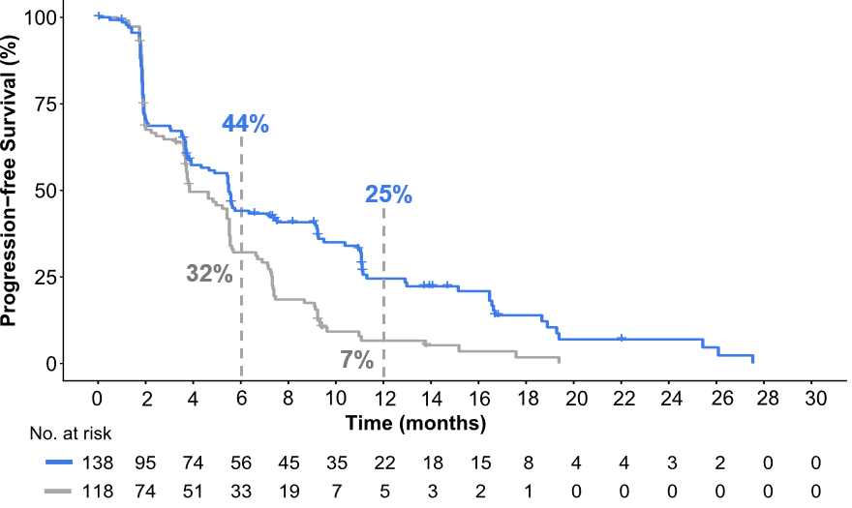
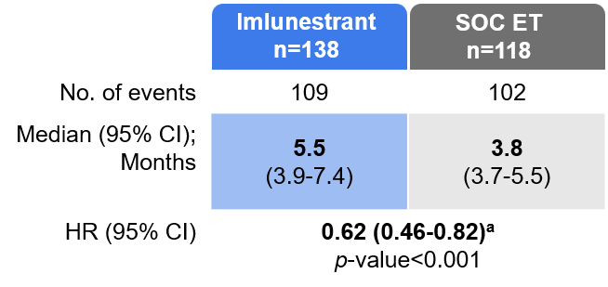
EMBER-3 Primary Endpoint: Imlunestrant vs SOC ET
Investigator-Assessed PFS in Patients With ESR1m
Imlunestrant led to a 38% reduction in the risk of progression or death in patients with ESR1m
OS (secondary endpoint): Interim OS in the ESR1m population favored imlunestrant 34.5 vs 23.1 months (HR, 0.60; 95% CI, 0.43–0.86), but did not cross the
pre-specified significance boundary. Approval was based on PFS.
The median follow-up was 16.7 months in the imlunestrant arm and 13.8 months in the SOC ET arm. ª Due to evidence of non-proportional hazards, a sensitivity analysis of PFS using RMST was conducted. Estimated RSMT at 19.4 months was 7.9 months (95% CI 6.8-9.1) in the imlunestrant arm vs 5.4 months (95% CI 4.6-6.2) in the SOC ET arm [difference 2.6 months (1.2.-3.9)].
Jhaveri KL, et al. Ann Oncol. 2026;37(4):532-543.
Notes:
At the primary progression-free survival (PFS) analysis, the phase III EMBER-3 trial in endocrine therapy pretreated patients with estrogen receptor (ER)-positive, human epidermal growth factor receptor 2 (HER2)-negative advanced breast cancer (ABC) demonstrated significant PFS benefit with imlunestrant versus standard of care (SOC: fulvestrant or exemestane) in patients with ESR1 mutations (ESR1m) and with imlunestrant—abemaciclib versus imlunestrant in all patients, regardless of ESR1m.

Slide 24
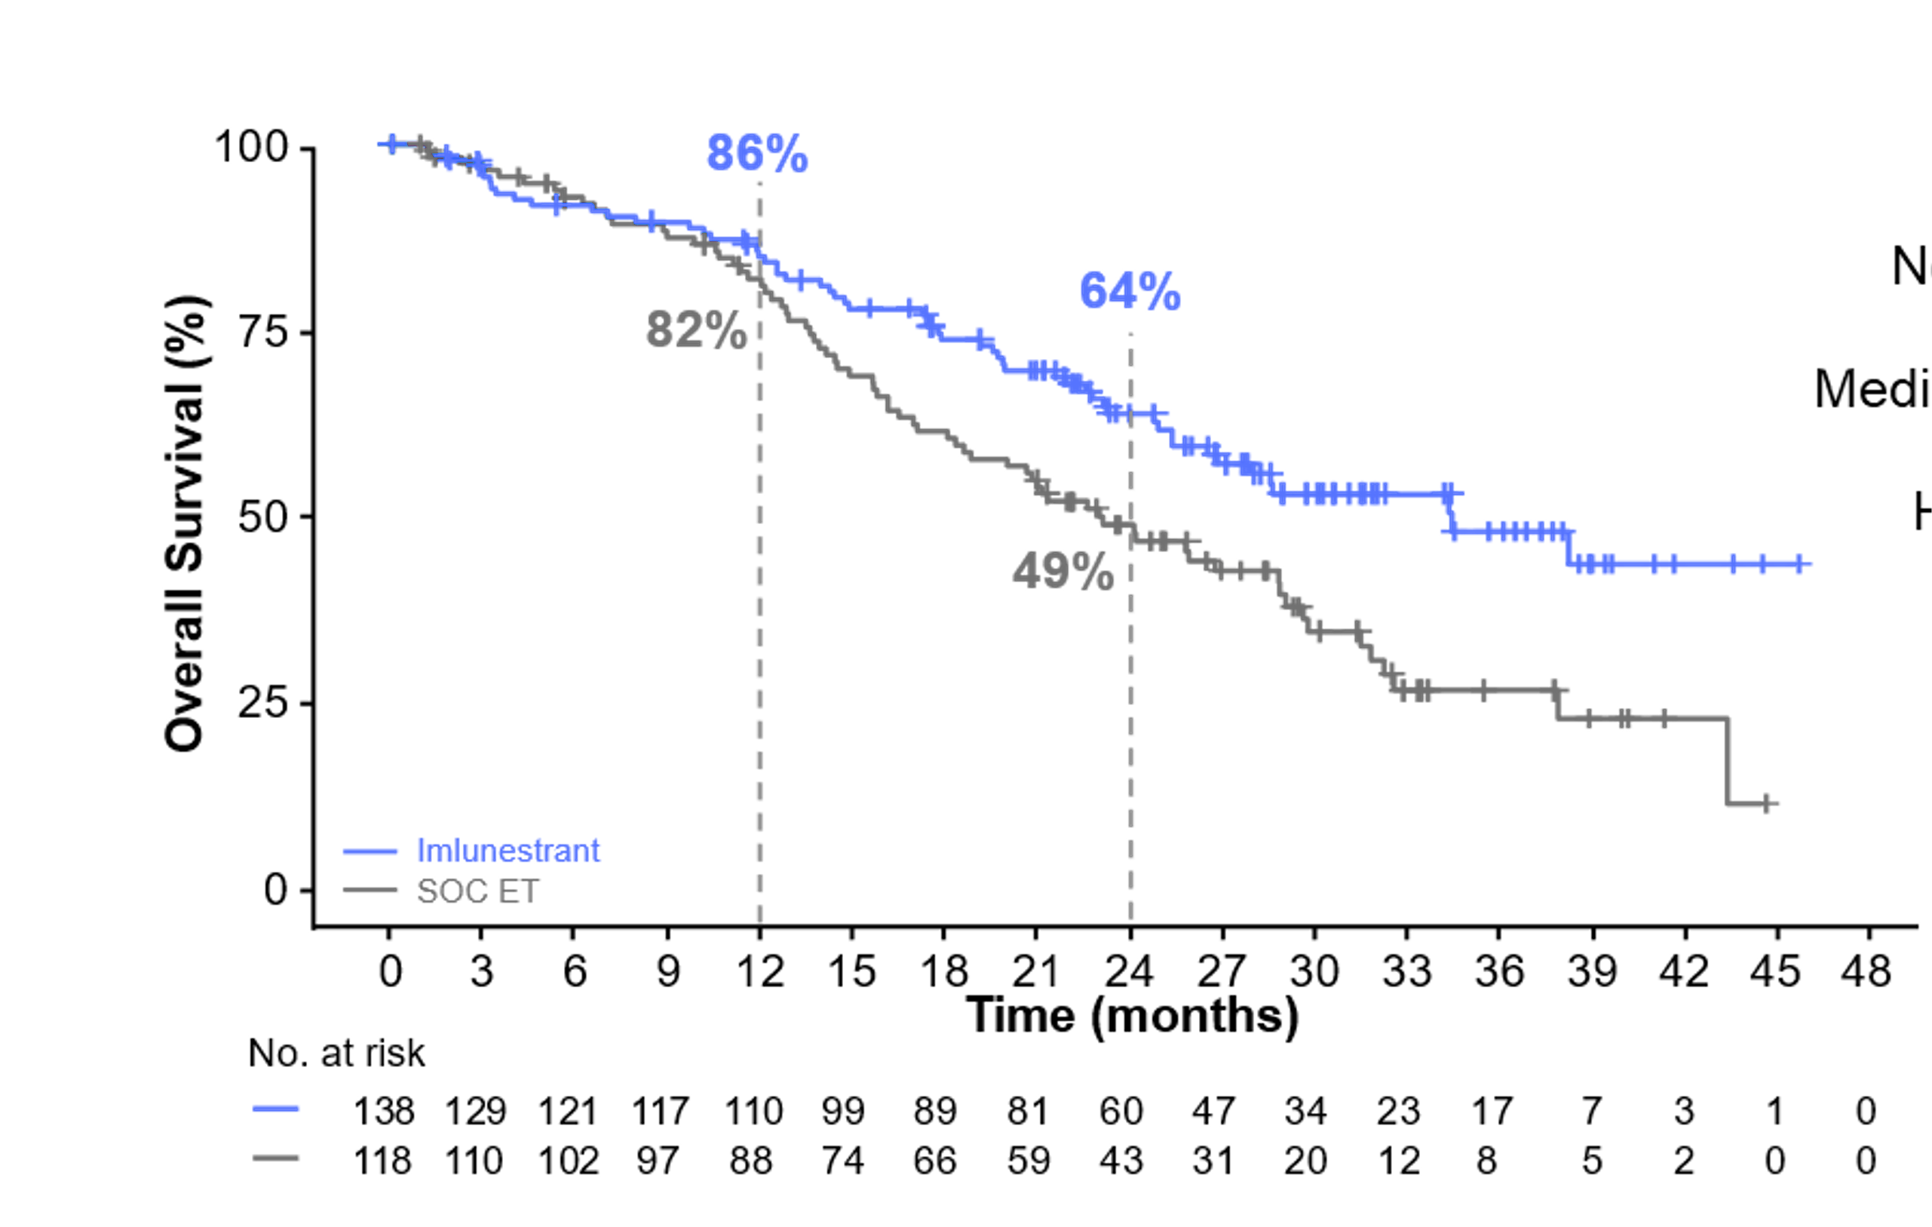
EMBER-3: Interim OS of Imlunestrant vs SOC ET at 50% Maturity in Patients with ESR1m
 | Imlunestrant n=138 | SOC ET n=118
No. of events | 57 | 71
Median (95%CI) | 34.5 (25.4-NR) | 23.1 (18.4-28.9)
HR (95% CI) | 0.60 (0.43–0.86) P-value = 0.0043*
Imlunestrant led to an ~11-month numerical improvement in median OS in patients with ESR1m
* P-value did not achieve prespecified threshold for significance (P = 0.0000004 at IA2).
Note: The median follow-up was 29.5 months across both arms.
Jhaveri KL, et al. Ann Oncol. 2026;37(4):532-543.
Notes:
In patients with ESR1m, median OS (mOS) was 34.5 months for imlunestrant versus 23.1 months for SOC [hazard ratio (HR) 0.60, 95% confidence interval (CI) 0.43-0.86, P = 0.0043, boundary for significance not reached]. In all patients regardless of ESR1m, mOS was not reached with imlunestrant—abemaciclib versus 34.4 months with imlunestrant (HR 0.82, 95% CI 0.59-1.16, P = 0.2622).

Slide 25
Phase 3 VERITAC-2 Trial: Study Design
Key Eligibility Criteria
Age ≥18 years old
ER+/HER2- advanced or metastatic breast cancer
Prior therapy:
  1 line of CDK4/6i + ET
  ≤1 additional ET
  Most recent ET for ≥6 months
  No SERD (eg, fulvestrant, elacestrant)
  No chemotherapy for advanced disease
Radiological progression during or
after the last line of therapy
28-Day Treatment Cycles
Vepdegestrant (n = 313)
200 mg orally (once daily)
Primary Endpoints:
PFS by BICR in
  ESR1m population
  All patients
Secondary Endpoints:
OS (key secondary)
CBR^{b} and ORR by BICR
AEs
Randomization (1:1)
Fulvestrant (n = 311)
500 mg IM
(days 1 and 15 of cycle 1;
day 1 of subsequent cycles)
Stratification Factors:
ESR1 mutationª (yes vs no)
Visceral disease (yes vs no)
Data cutoff date: Jan 31, 2025
ClinicalTrials.gov identifier: NCT05654623.
ª ESR1 mutation status was assessed in ctDNA by Foundation Medicine, except in China, where Origmed testing was used.
^{b} Rate of confirmed complete response, partial response, or stable disease ≥24 weeks.
Hamilton EP, et al. ASCO 2025. Abstract LBA1000. Campone M, et al. N Engl J Med. 2025;393(6):556-568.
Notes:
In this phase 3, open-label, randomized trial, we enrolled patients with ER-positive, human epidermal growth factor receptor 2 (HER2)–negative advanced breast cancer who had received one previous line of cyclin-dependent kinase 4 and 6 inhibitor therapy plus one line of endocrine therapy (and up to one additional line of endocrine therapy). Patients were randomly assigned in a 1:1 ratio to receive vepdegestrant at a dose of 200 mg orally once every day of each 28-day cycle or fulvestrant at a dose of 500 mg, administered intramuscularly, on day 1 and day 15 of cycle 1 and on day 1 of subsequent cycles, with randomization stratified according to ESR1-mutation status and presence or absence of visceral disease. The primary end point was progression-free survival as assessed by blinded independent central review among the patients with ESR1 mutations and among all the patients who underwent randomization. Progression-free survival was estimated with Kaplan–Meier methods and hazard ratios with a stratified Cox proportional-hazards model.
A total of 624 patients underwent randomization; 313 were assigned to receive vepdegestrant, and 311 to receive fulvestrant.

Slide 26
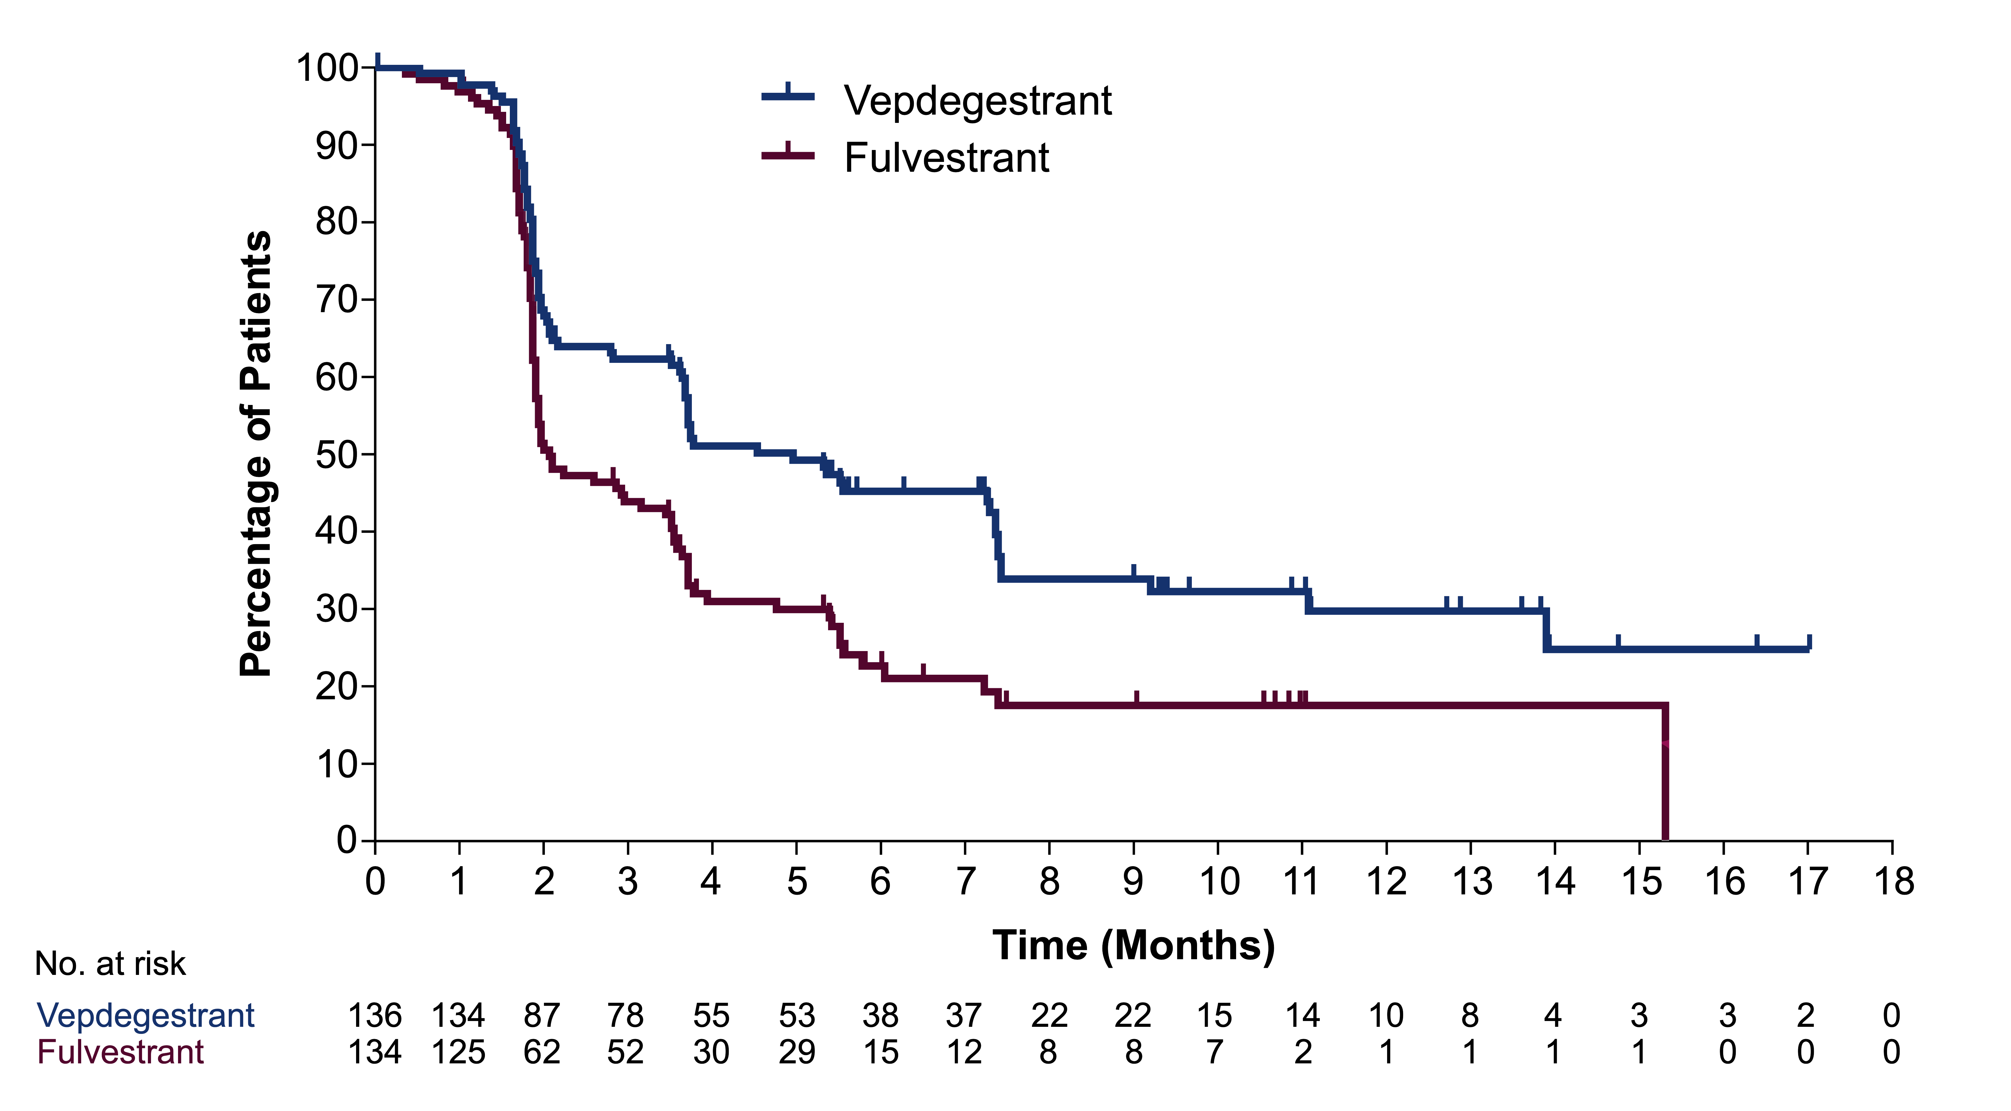
VERITAC-2: PFS by BICR in Patients With ESR1m
 | Vepdegestrant​ n = 136 | Fulvestrant​ n = 134
Median follow-up, months | 7.4 | 6.0
Events, n (%) | 82 (60) | 103 (77)
Median PFS, months (95% CI) | 5.0 (3.7–7.4) | 2.1 (1.9–3.5)
Stratified HR (95% CI) | 0.58 (0.43–0.78) 2-sided P < 0.001
Hamilton EP, et al. ASCO 2025. Abstract LBA1000. Campone M, et al. N Engl J Med. 2025;393(6):556-568.
Notes:
Among the 270 patients with ESR1 mutations, the median progression-free survival was 5.0 months (95% confidence interval [CI], 3.7 to 7.4) with vepdegestrant and 2.1 months (95% CI, 1.9 to 3.5) with fulvestrant (hazard ratio, 0.58 [95% CI, 0.43 to 0.78]; P<0.001). Among all the patients, the median progression-free survival was 3.8 months (95% CI, 3.7 to 5.3) with vepdegestrant and 3.6 months (95% CI, 2.6 to 4.0) with fulvestrant (hazard ratio, 0.83 [95% CI, 0.69 to 1.01]; P=0.07).

Slide 27
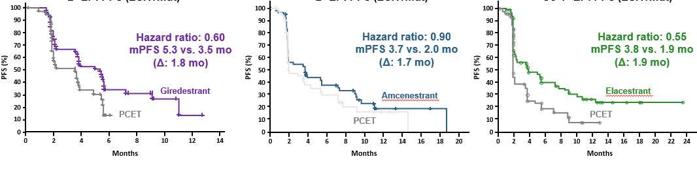
Signal in Patients With ESR1 Mutations From Oral SERDs Over SOC ET Consistent in Randomized Trials¹⁻³
aceIERA BC
2° EP: PFS (ESR1m)
AMEERA-3
2° EP: PFS (ESR1m)
EMERALD
Co-1° EP: PFS (ESR1m)
PFS,%
PFS,%
PFS,%
Amcenestrant
Elacestrant
Time, mo
Time, mo
Time, mo
40% across the board still with early progression on monotherapy and 60% still have
<6 months benefit, still indicating a need for combination approaches

Slide 28
EMBER-3 Primary Endpoint: PFS of Imlunestrant + Abemaciclib vs Imlunestrant in All Patients
10
0
6
Imlunestrant + abemaciclib
n=213
Imlunestrant
n=213ª
6%
7
5
4
No. of events |  | 144 | 174
Median (95% CI) |  | 10.9 (7.5-12.5) | 5.5 (3.8-5.6)
HR (95% CI) |  | 0.59 (0.47-0.74)
 |  | Nominal P-valueª < 0.0001
3%
3
5
4%
0
2
Progression-free Survival (%)
6%
4
0%
2
5
2
8%
1
Imlunestrant
8%
1
+ abemaciclib
3%
0
Imlunestrant
0
3
6
9
1
2
1
5
1
8
2
1
2
4
2
7
3
0
3
3
3
6
3
9
Time (months)
N
o. at risk
2
1
3
1
5
9
1
2
2
1
0
1
7
8
7
0
5
9
5
4
3
6
2
0
1
4
1
0
2
0
2
1
3
1
3
0
7
8
7
3
5
4
4
6
3
5
2
6
1
8
1
4
8
4
0
0
PFS benefit of imlunestrant + abemaciclib was maintained in all patients
ªReached formal statistical significance at primary PFS analysis.
Notes: Efficacy analyses confined to the imlunestrant population concurrently randomized to imlunestrant + abemaciclib treatment arm. Median follow-up was 25.2 months across both arms.
Jhaveri KL, et al. Ann Oncol. 2026;37(4):532-543.
Notes:
Updated PFS demonstrated sustained benefit. Notably, in all patients regardless of ESR1m, the median PFS of imlunestrant—abemaciclib versus imlunestrant was 10.9 versus 5.5 months (HR 0.59, 95% CI 0.47-0.74, nominal P < 0.0001).

Slide 29
EMBER-3: Subgroup Analysis of PFS of Imlunestrant + Abemaciclib vs Imlunestrant in CDK4/6i Pretreated Patients
 | Imlunestrant + abemaciclib n=139 | Imlunestrant n=140
No. of events | 97 | 120
Median (95%CI) | 9.1 (7.2-11.3) | 3.7 (2.1-5.5)
HR (95% CI) | 0.53 (0.40–0.69) Nominal P-value < 0.0001
100
75
50
25
0
+
+
+
+
+
63%
+
+
CDK4/6i pretreated patients represent 65% of the patient population
+
+
+
38%
Progression-free Survival (%)
+
+
31%
23%
32%
+
+
+
+
+
+
+
+
+
+
+
+
+
+
+
+
+
Imlunestrant
+ abemaciclib
Imlunestrant
18%
+
+
+
+
+
14%
9%
+
+
0 3 6 9 12 15 18 21 24 27 30 33 36 39
No. at risk
Time (months)
139 100 76 61 46 43 37 34 21 13 9 5 1 0
140 73 40 35 23 21 17 10 7 6 4 2 0 0
Consistent benefit of imlunestrant + abemaciclib maintained in patients previously treated with a CDK4/6i
Jhaveri KL, et al. Ann Oncol. 2026;37(4):532-543.

Slide 30
EMBER-3: Subgroup Analysis PFS of Imlunestrant + Abemaciclib vs. Imlunestrant in CDK4/6i Pretreated Patients by ESR1m Status
Patients with ESR1m
Patients without ESR1m
+
100
75
50
25
0
+
100
75
50
25
0
+
 | Imlunestrant + abemaciclib (n=53) | Imlunestrant (n=72)
No. of events | 38 | 65
Median (95% CI) | 11.1 (7.2-16.5) | 5.5 (3.1-5.6)
HR (95% CI) | 0.42 (0.28-0.64)
 | Imlunestrant + abemaciclib (n=86) | Imlunestrant (n=68)
No. of events | 59 | 55
Median (95% CI) | 7.4 (5.6-11.1) | 2.8 (1.9-3.9)
HR (95% CI) | 0.58 (0.40-0.84)
+
+
+
+
+
+
+
+
+
+
Progression-free Survival (%)
Progression-free Survival (%)
Nominal P-value <0.0001
Nominal P-value <0.0036
+
+
+
+
+
+
+
+
+
+
+
+
+
+
+
+
+
+
Imlunestrant
+ abemaciclib
Imlunestrant
+
+
Imlunestrant
+ abemaciclib
Imlunestrant
+
+
+
+
+
+
0 3 6 9 12 15 18 21 24 27 30 33 36 39
0 3 6 9 12 15 18 21 24 27 30 33 36 39
No. at risk
Time (months)
No. at risk
Time (months)
53 39 31 28 21 19 16 15 5 2 1 1 0 0
72 43 22 20 11 9 6 2 1 1 1 0 0 0
86 61 45 33 25 24 21 19 16 11 8 4 1 0
68 30 18 15 12 12 11 8 6 5 3 2 0 0
Consistent benefit of imlunestrant + abemaciclib maintained regardless of ESR1m status
Jhaveri KL, et al. Ann Oncol. 2026;37(4):532-543.

Slide 31
EMBER-3 Subgroup Analysis: PFS of Imlunestrant + Abemaciclib vs Imlunestrant by PI3K Pathway Mutation Statusª
Patients With PI3K Pathway Mutation
Patients Without PI3K Pathway Mutation
Imlunestrant
+ abemaciclib
n=88
Imlunestrant
n=84
Imlunestrant
+ abemaciclib
n=109
Imlunestrant
n=112
10
10
0
0
No. of events |  | 63 | 78
Median (95% CI) |  | 7.6 (5.6-11.1) | 3.8 (3.1-5.5)
HR (95% CI) |  | 0.57 (0.41-0.80)
 |  | Nominal P-value = 0.0010
No. of events |  | 70 | 86
Median (95% CI) |  | 11.3 (7.6-19.3) | 5.6 (4.4-9.2)
HR (95% CI) |  | 0.59 (0.43-0.81)
 |  | Nominal P-value = 0.0009
7
7
5
5
n-free Survival (%)
n-free Survival (%)
5
5
0
0
io
io
s
s
2
2
5
s
5
s
e
e
r
Imlunestrant
r
Imlunestrant
og
+ abemaciclib
og
+ abemaciclib
r
r
P
0
Imlunestrant
P
0
Imlunestrant
0
3
6
9
1
2
1
5
1
8
2
1
2
4
2
7
30
0
3
6
9
1
2
1
5
1
8
2
1
2
4
2
7
3
0
3
3
3
6
3
9
Ti
m
e (months)
Ti
m
N
e (months)
o. at risk
N
o. at risk
1
0
9
8
6
7
1
5
7
4
7
4
4
4
0
3
5
2
6
1
9
1
4
1
8
0
2
0
8
6
0
4
1
3
4
2
2
19
1
3
1
3
4
0
0
11
2
6
8
4
5
4
1
3
3
2
6
2
2
1
6
1
8
2
9
7
4
0
0
4
49
2
3
2
2
1
2
1
1
5
2
2
2
0
Consistent benefit of imlunestrant + abemaciclib maintained regardless of PI3K pathway mutation

Slide 32
EMBER-3: Interim OS of Imlunestrant + Abemaciclib vs Imlunestrant at 33% Maturity in All Patients
 | Imlunestrant + abemaciclib n=213 | Imlunestrant n=213ª
No. of events | 64 | 76
Median (95%CI) | NR | 34.4 (29.3-NR)
HR (95% CI) | 0.82 (0.59–1.16) P-value = 0.2622*
Imlunestrant
+ abemaciclib
Imlunestrant
Separation of OS curves observed at 24 months; median OS not reached

Slide 33
TODAY: Oral SERDs and PROTACs – Testing Smarter, Treating Better in ER+/HER2− mBC
Foundations of Team-Based AE Monitoring and Adherence

Slide 34
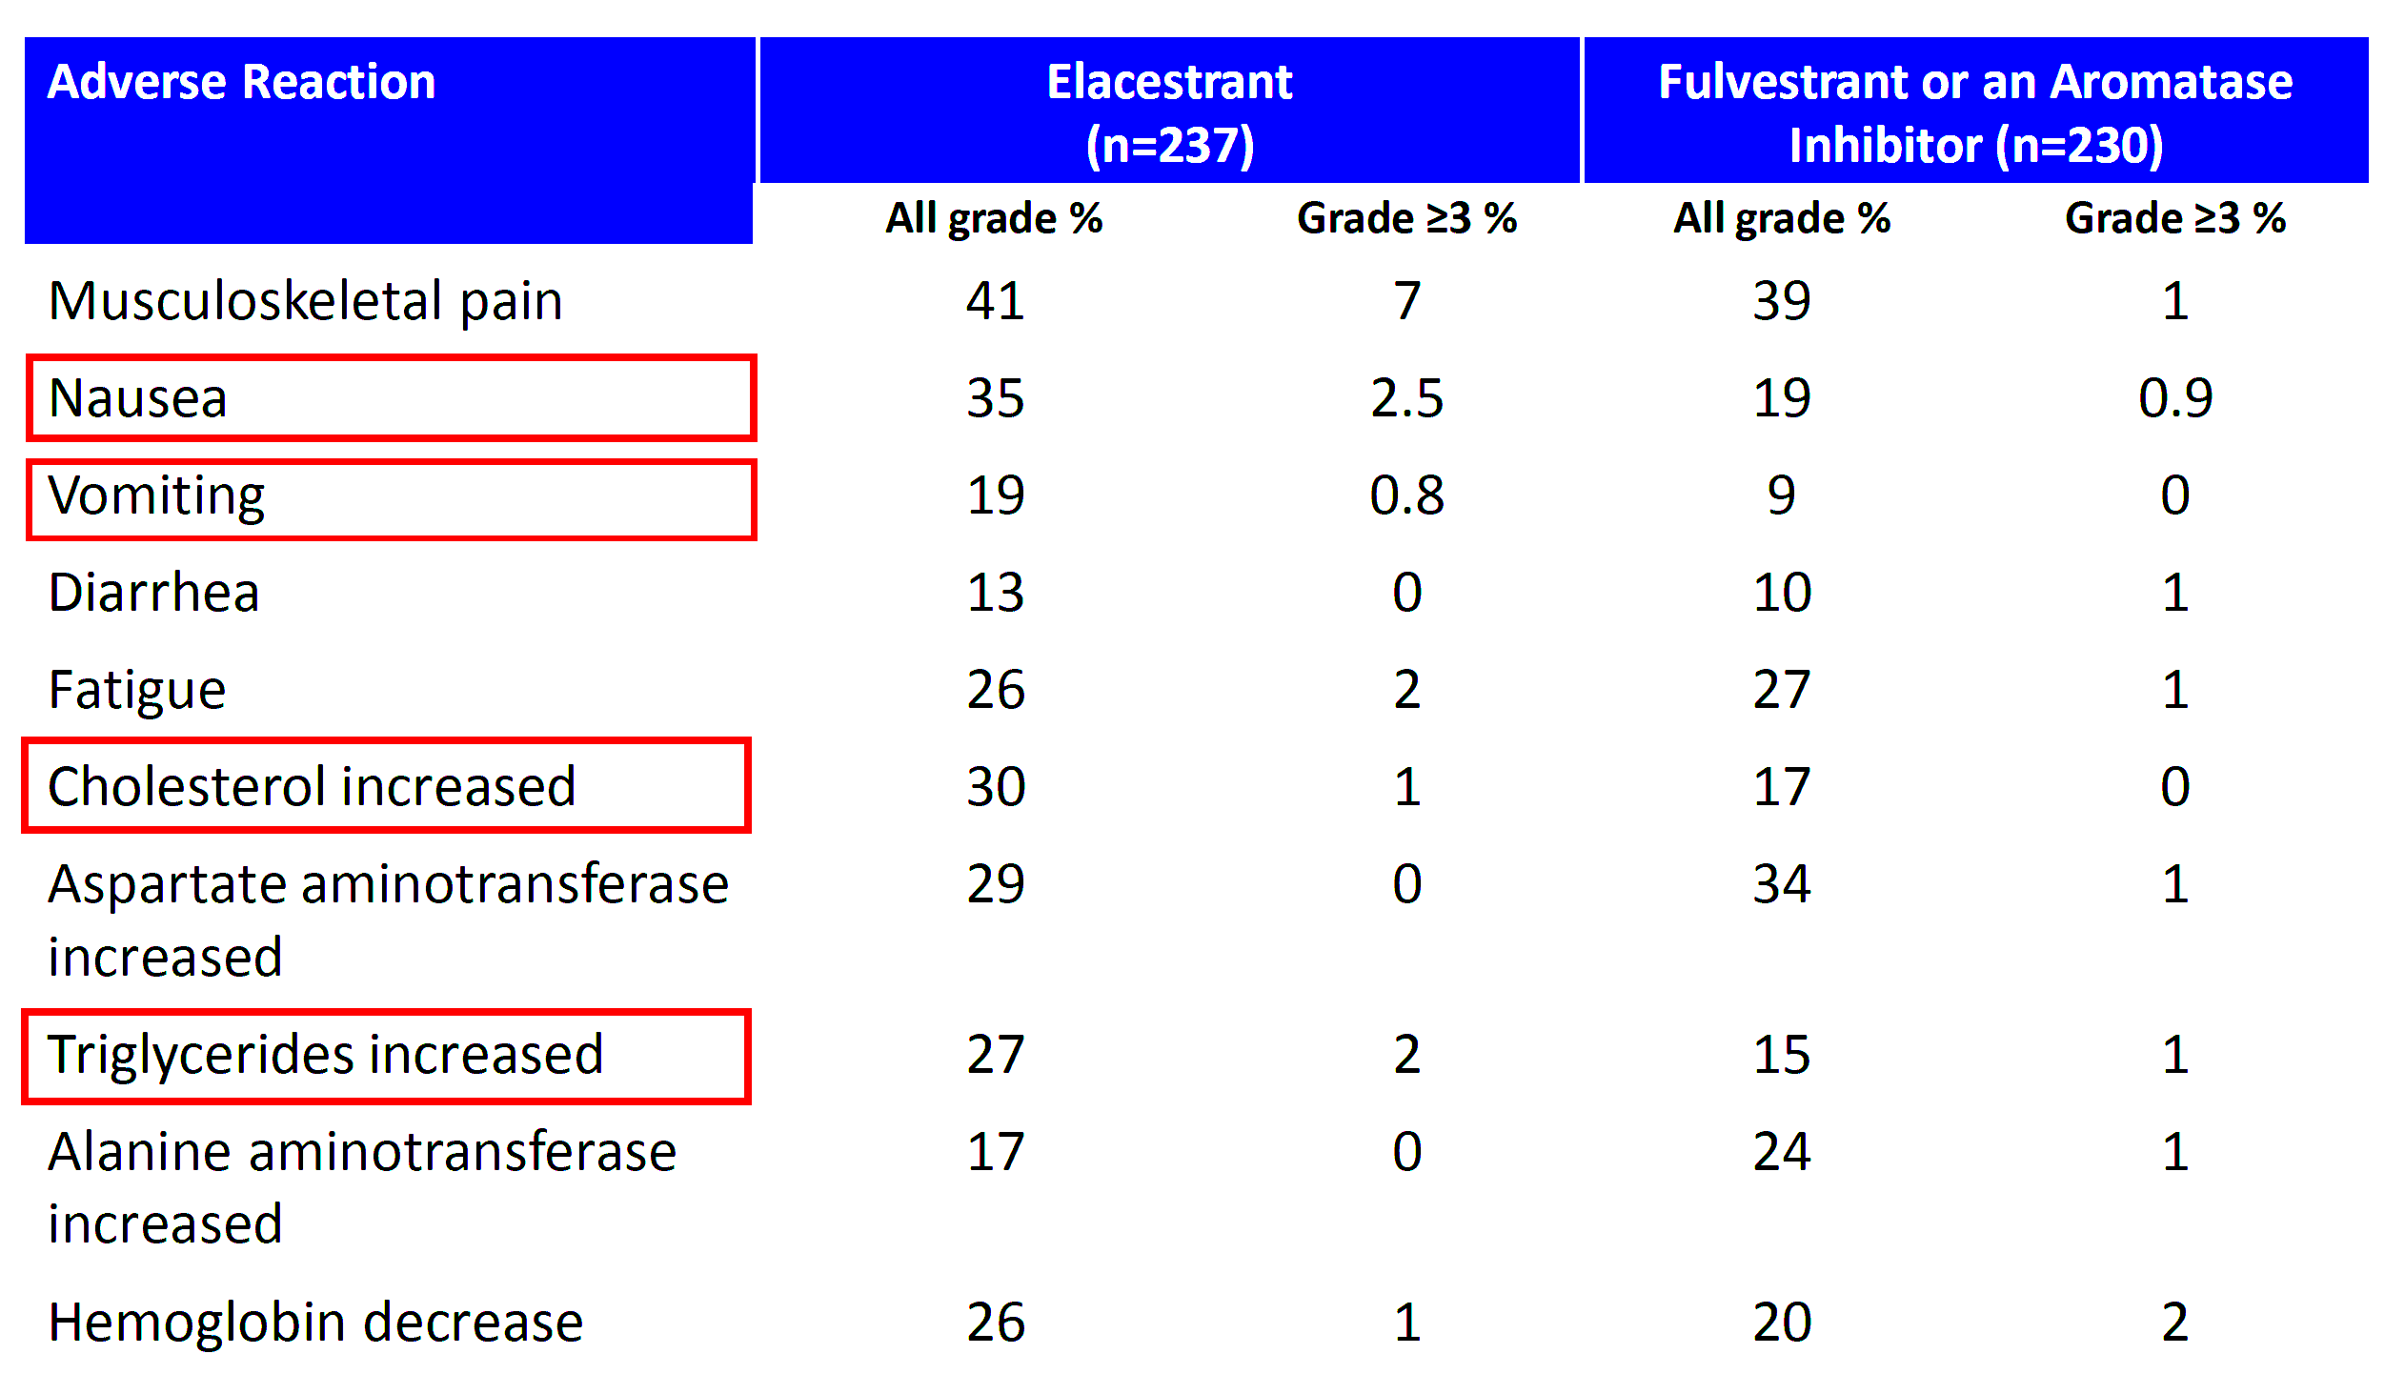
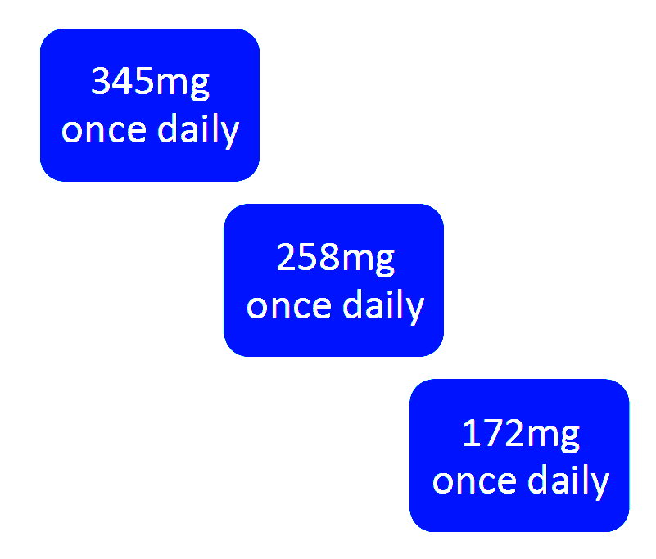
EMERALD: Safety
Safety Summary
Most AEs, including nausea, were grade 1-2
No grade 4 TRAEs were reported
Discontinuations of therapy due to TRAEs:
    Elacestrant arm: 3.4%
    SOC arm: 0.9%
No hematologic safety signal was observed
None of the patients in either treatment arm experienced
sinus bradycardia
Nausea Summary | Elacestrant (n=237) | SOC (n=230)
Grade 3 nausea, n (%) | 6 (2.5) | 2 (0.9)
Dose reduction rate due to nausea, n (%) | 3 (1.3) | N/A
Discontinuation rate due to nausea, n (%) | 3 (1.3) | 0
Antiemetic use, % | 8 | 10.3 (AI) 1.3 (fulvestrant)
Monitor lipid profile prior to starting elacestrant and periodically while
on treatment

Slide 35
EMBER-3: Safety
TEAEs in ≥25% of Patients, % | Imlunestrant + abemaciclib n=208 |  | Imlunestrant n=327 |  | SOC ​ET n=324 ​
 | Any Grade ​ | Grade ≥3 ​ | Any Grade ​ | Grade ≥3 ​ | Any Grade ​ | Grade ≥3 ​
Patients with ≥1 TEAE | 98 | 54 | 85 | 20 | 85​ | 22
Diarrhea ​ | 86 | 9 | 23​ | <1 ​ | 12 | 0
Neutropenia ​ | 50 | 22​ | 6 | 3 | 5 | 2
Nausea ​ | 50 | 2​ | 18 | <1 ​ | 14 | 0
Anemia ​ | 46 | 10 ​ | 11​ | 2 | 13 | 3
Fatigue ​ | 41 | 5 | 24 | <1 ​ | 14 | 1
Vomiting ​ | 32 | <1 ​ | 9 | 1 | 5 | <1 ​
Leukopenia ​ | 29 | 4 ​ | 6 | 1 | 5 | 0
Hypercreatininemia ​ | 25 | 1 ​ | 4​ | <1 ​ | 3 | 0
TEAEs leading to discontinuation | 9 |  | 5 |  | 1
Treatment-related | 5 |  | 2 |  | 0
The safety profiles remained consistent with the known characteristics of imlunestrant and abemaciclib

Slide 36
VERITAC-2: Safety
Vepdegestrant vs Fulvestrant in ER+/HER2– MBC
Safety Overview, % | Vepdegestrant (n=312) | Fulvestrant (n=307)
TEAEs, %
Any grade | 87 | 81
Grade ≥3 | 23 | 18
Serious | 10 | 9
Leading to discontinuation | 3 | 1
Leading to dose reduction | 2 | NA
TRAEs, %
Any grade | 57 | 40
Grade ≥3 | 8 | 3
TEAEs in >10% of Patients in Either Group, %ª | Vepdegestrant (n=312) |  | Fulvestrant (n=307)
 | Any Grade | Grade ≥3 | Any Grade | Grade ≥3
Fatigue^{b} | 27 | 1 | 16 | 1
ALT increased | 14 | 1 | 10 | 1
AST increased | 14 | 1 | 10 | 3
Nausea | 13 | 0 | 9 | 1
Anemia^{c} | 12 | 2 | 8 | 3
Neutropenia^{d} | 12 | 2 | 5 | 1
Back pain | 11 | 1 | 7 | <1
Arthralgia | 11 | 1 | 11 | 0
Decreased appetite | 11 | <1 | 5 | 0
QT Prolongation
TEAEs: vepdegestrant, 10%; fulvestrant, 1%
A QT interval substudy (n=88) confirmed a mild increase (11.1 ms) from baseline in mean QTcF, with upper 90% CI (13.7 ms) <20 ms indicating no large QT-prolonging effect

Slide 37
Adverse Events: Oral SERDs and PROTACs
Elacestrant
Imlunestrant
  Most common: increased cholesterol, AST, ALT, triglycerides, creatinine; decreased hemoglobin, sodium; musculoskeletal pain, nausea, fatigue, vomiting, decreased appetite, diarrhea, headache, constipation, abdominal pain, hot flush, and dyspepsia
  Monitor lipid profile prior to starting and periodically while taking elacestrant
  Take with food to reduce nausea and vomiting
  Most common: decreased hemoglobin, neutrophils, calcium, platelets; increased AST, ALT, triglycerides, cholesterol; musculoskeletal pain, fatigue, diarrhea, nausea, constipation, and abdominal pain
  Take on an empty stomach at least 2 hours before food, or 1 hour after food
Camizestrant
Vepdegestrant
Most common: decreased neutrophils, leukocytes, hemoglobin, lymphocytes, and platelets; visual disturbances, and fatigue
Bradycardia: Monitor heart rate more frequently during the first 30 days
Warning: Arrhythmia risk with concomitant use of QTC interval prolonging drugs
Obtain ECG prior to initiation and monitor heart rate and QTc interval during treatment. Assess and correct electrolyte abnormalities prior to initiation and during treatment
Most common: decreased WBCs, hemoglobin, neutrophils, blood potassium, platelets; increased AST, ALT, alkaline phosphatase, bilirubin; musculoskeletal pain, fatigue, nausea, constipation, decreased appetite, and electrocardiogram QT prolonged
QTc Interval Prolongation: Monitor ECGs and electrolytes prior to initiation. Correct hypokalemia and hypomagnesemia
prior to and during treatment. Repeat ECGs as clinically indicated. Withhold, reduce dose, or permanently discontinue
based on severity
Take with food
Notes:
Overall, the toxicity profile for these agents is relatively, mild and moderate. Most of the toxicities are going to be grade one and grade two, although in some patients we may have grade three toxicities as well.
When we look at elacestrant, we find some hyperlipidemia, and this is where there's an FDA mandate to actually check lipid profile. Now, this is interesting because it's telling us to check the lipid profile before we start the drug, and then it leaves it under, the discretion of the treating physician as to how often to check it afterwards.
We know this is a class effect, so you may see that the lipids change with other oral SERDs as well. Elacestrant may also have some GI toxicity, some GERD, and some upset stomach, so it tends to be better if we take it with food.
Imlunestrant has a relatively similar toxicity profile to elacestrant with some GI toxicity. Again, relatively mild. So when you look at these agents, they're pretty similar when it comes to their toxicity profile.
When looking at the other SERDs, talking about camizestrant here, there's two other toxicities to keep in mind. One is photopsia, and these are flashes of light that happen. They don't seem to have any other issues with vision. We don't seem to have to take the patients, to send the patients to an ophthalmologist or do any other ophthalmologic exams. But this might be worrisome for some patients and definitely something we need to discuss with them. And there may be some bradycardia, which tends to be all very subclinical.
And with giredestrant, we also have some bradycardia, which again, was mostly grade one, very subclinical. We don't need to be doing EKGs, but something that you may want to make your patients aware so that they're not surprised if they do find that bradycardia happening.
Vepdegestrant seems to be pretty similar to elacestrant and imlunestrant with very mild GI toxicities, but otherwise relatively well-tolerated as an agent.

Slide 38
Discussion:
Foundations of Team-Based AE Monitoring and Adherence
Pharmacy-led
start-up counseling
Nursing check-ins
Dose-interruption/
adjustment options
Preventing premature discontinuation:
  Teach-back
  Access navigation
  Refill cadence
Notes:
Now, these are the single-agent toxicities. When we're adding other treatments, such as everolimus, abemaciclib, or other CDK4/6 inhibitors, as you can imagine, we're adding to the toxicities of those agents. And so if you're adding, abemaciclib, you may see a little bit more diarrhea. If you're adding everolimus, you may see some more stomatitis or rash and so forth.
So these are things that we need to be aware of, and this might be able to help us make decisions as to whether to use these agents as single agents or use them in combination.

Slide 39
TOMORROW: Integrating Emerging Oral SERDs, PROTACS, Combination Data, and Evidence-Based Sequencing
Future ESR1 Monitoring in First-Line
Expanding the Possibilities: How Emerging Oral SERDs May Redefine the Landscape

Slide 40
Emerging and Recently Approved Strategies
Combination Therapy
First-Line Therapy
EMBER-3
  Imlunestrant + abemaciclib (ESR1-mutated)
  Approved in United States: September 2026
evERA
  Giredestrant + everolimus
ADELA
  Elacestrant + everolimus
persevERA
  Giredestrant + placebo + palbociclib vs letrozole + placebo palbociclib
pioNERA
  Giredestrant + CDK4/6 inhibitor
OPERA-02
  Palazestrant + ribociclib vs letrozole + ribociclib
SERENA-4
  Camizestrant + palbociclib vs anastrozole + palbociclib
SERENA-6
  Camizestrant + CDK4/6 inhibitor vs aromatase inhibitor + CDK4/6 inhibitor
  ctDNA-guided approach to detect emergence of endocrine resistance (emergent ESR1 mutation) and switch to camizestrant with continuation of a CDK4/6 inhibitor during first-line therapy before disease progression
  Approved in European Union: July 2026
  Approved in United States: September 2026
Notes:
Recently approved strategies include combination therapy, such as imluenstrant + abemaciclib, and first-line treatment, such as camizestrant + a CDK4/6 inhibitor. Others are being evaluated in clinical trials, including giredestrant in evERA, persevERA, and pioNERA; elacestrant in ADELA, palazestrant in OPERA-2, and camizestrant in SERENA-4.

Slide 41
Phase 3 evERA Trial: Study Design
Key eligibility criteria*
ER+/HER2- ABC (1-3L of therapy)
≤2 prior lines of ET in the ABC setting
PD or relapse during/post-CDK4/6i + ET
No prior chemotherapy in the ABC setting
Measurable disease per RECIST v1.1 or evaluable
bone metastases
Enrollment period: August 2022 to October 2024
N = 373*
Giredestrant + everolimus†
Until PD
or
unacceptable toxicity
R 1:1
SOC ET† + everolimus†
†Exemestane/fulvestrant/tamoxifen
† Dexamethasone mouthwash prophylaxis and treatment was
strongly recommended per SWISH trial protocol
* Trial was enriched to 55% of patients with ESR1m at baseline (centrally tested via circulating tumour DNA)
Coprimary endpoints (RECIST v1.1)
INV-PFS in patients whose tumors had ESR1m
INV-PFS in the ITT population
Key secondary endpoints
OS
INV-assessed ORR, DoR
Stratification factors
Prior treatment with fulvestrant (yes vs no)
ESR1m (yes vs no/indeterminate)
Site of disease (visceral [lung and/or
liver involvement] vs non-visceral)
Mayer E, et al. ESMO 2025. Abstract LBA16.
Notes:
Patients had ER+, HER2– aBC with disease progression (PD) or relapse during/post-CDK4/6i + ET. Randomisation was 1:1 to once-daily oral 30 mg GIRE + 10 mg E or SOC ET (exemestane/fulvestrant/tamoxifen) + E until PD or unacceptable toxicity. 373 pts were randomised; 183 to GIRE + E and 190 to SOC ET + E. Data cutoff was 16 July 2025; median follow-up was 18.6 months. ∼55% of pts had an ESR1m.

Slide 42
evERA: PFS by Investigators in the ESR1m Population
Giredestrant + everolimus
n = 102
SOC ET + everolimus
n = 105
 | Giredestrant + everolimus (n = 102) | SOC ET + everolimus (n = 105)
Events, n (%) | 63 (61.8) | 89 (84.8)
Median, mo (95% CI) | 9.99 (8.08, 12.94) | 5.45 (3.75, 5.62)
Stratified HR (95% CI) | 0.38 (0.27, 0.54); P < 0.0001
Exploratory analysis: INV-PFS by SOC ET
100
80
66.1%
60
INV-PFS (%)
40.5%
40
38.1%
 | Total, n |  | Unstratified HR (95% CI)
Exemestane | 67 |  | 0.40 (0.28, 0.58)
Fulvestrant | 31 |  | 0.44 (0.28, 0.69)
20
15.2%
0
Giredestrant
+ everolimus better
SOC ET
+ everolimus better
0
3
6
9
12
15
18
21
24
27
30
No. at risk
Time (mo)
Giredestrant + everolimus
SOC ET + everolimus
102
105
85
67
61
35
52
25
28
10
13
2
6
1
2
1
2
1
Combination therapy with giredestrant + everolimus led to a clinically meaningful
62% reduction in the risk of progression or death in patients with ESR1m
Data cutoff: July 16, 2025. PFS by blinded independent radiologist was similar to INV-PFS: Median PFS was 11.14 mo (giredestrant + everolimus) and 5.68 mo (SOC ET + everolimus); stratified HR, 0.49; 95% CI: 0.34, 0.71.
Mayer E, et al. ESMO 2025. Abstract LBA16.
Notes:
GIRE + E showed statistically significant and clinically meaningful improvements in INV-PFS in ER+, HER2– aBC post-CDK4/6i, for both the ESR1m and ITT pt populations.

Slide 43
evERA: PFS by Investigators in the ITT Population
Giredestrant + everolimus
n = 183
SOC ET + everolimus
n = 190
 | Giredestrant + everolimus (n = 102) | SOC ET + everolimus (n = 105)
Events, n (%) | 126 (68.9) | 163 (85.8)
Median, mo (95% CI) | 8.77 (6.60, 9.59) | 5.49 (4.01, 5.59)
Stratified HR (95% CI) | 0.56 (0.44, 0.71); P < 0.0001
Exploratory analysis: INV-PFS by SOC ET
100
80
60
57.4%
INV-PFS (%)
40
39.6%
34.1%
 | Total, n |  | Unstratified HR (95% CI)
Exemestane | 141 |  | 0.55 (0.43, 0.71)
Fulvestrant | 39 |  | 0.59 (0.40, 0.86)
20
18.1%
0
Giredestrant
+ everolimus better
SOC ET
+ everolimus better
0
3
6
9
12
15
18
21
24
27
30
No. at risk
Time (mo)
Giredestrant + everolimus
SOC ET + everolimus
183
190
149
131
95
68
70
50
47
27
29
14
14
7
3
3
3
3
1
1
Combination therapy with giredestrant + everolimus led to a clinically meaningful
44% reduction in the risk of progression or death in patients in the ITT population
Data cutoff: July 16, 2025. PFS by blinded independent radiologist was similar to INV-PFS: Median PFS was 10.32 mo (giredestrant + everolimus) and 7.26 mo (SOC ET + everolimus); stratified HR, 0.66; 95% CI: 0.50, 0.87.
Mayer E, et al. ESMO 2025. Abstract LBA16.

Slide 44
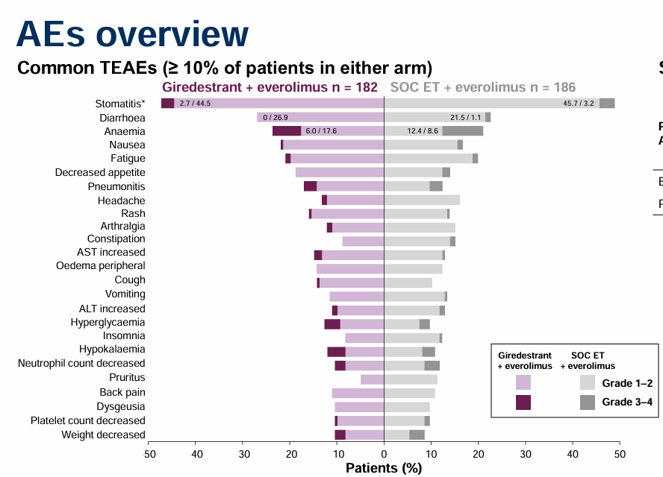
evERA: Phase 3 Giredestrant + Everolimus – Toxicity
Selected AEs
Patients with AE, n | Giredestrant + everolimus n = 182 |  | SOC ET + everolimus n = 186
 | Grade 1–2 | Grade 3–4 | Grade 1–2 | Grade 3–4
Bradycardia† | 7 (3.8) | 0 | 1 (0.5) | 0
Photopsia | 0 | 0 | 0 | 0
Patients with AE, n (%) | Giredestrant + everolimus n = 182 | SOC ET + everolimus n = 186
AEs with fatal outcome† | 5 (2.7) | 5 (2.7)
AEs leading to everolimus dose reduction‡ | 56 (30.8) | 49 (26.3)
AEs leading to discontinuation from treatment§
Giredestrant or SOC ET | 15 (8.2) | 12 (6.5)
Everolimus | 31 (17.0) | 22 (11.8)
Any | 31 (17.0) | 22 (11.8)
Mayer E, et al. ESMO 2025. Abstract LBA16.
Notes:
The most common adverse events (AEs) were stomatitis (47.3% in the GIRE + E arm [n = 182] vs 48.9% in the SOC ET + E arm [n = 186]), diarrhoea (26.9% vs 22.6%) and anaemia (23.6% vs 21.0%). The most common grade 3/4 AEs were anaemia (6.0% vs 8.6%), hypokalaemia (3.8% vs 2.7%), pneumonia (1.6% vs 4.3%) and stomatitis (2.7% vs 3.2%). Grade 1 bradycardia was reported (3.8% vs 0.5%) with no treatment interruptions/discontinuations. 8.2% and 6.5% of pts withdrew from GIRE and SOC ET, respectively, due to AEs.

Slide 45
ADELA: Study Design
A phase 3 study of elacestrant ± everolimus in patients with ER+/HER2− aBC and ESR1-mut tumors who progressed on prior ET + CDK4/6i
PHASE 3 OBJECTIVES
Primary objective:
Evaluate PFS based on BIRC‡
Key secondary objective:
Evaluate OS as determined locally by investigator
Secondary objectives:
Evaluate investigator-assessed PFS, BIRC- and investigator-assessed ORR, CBR, DOR, TTR, and best percentage of change in tumor burden,§ safety, and HRQoL
Elacestrant
345 mg* QD
Everolimus
7.5 mg† QD
Patient Population
ER+/HER2- aBC
ESR1-mut tumors
N=240
+
Arm A
R 1:1
Elacestrant
345 mg* QD
Everolimus
7.5 mgt QD
+
Placebo
Arm B
STRATIFICATION FACTORS
﻿﻿Presence of visceral metastases (yes vs no)
﻿﻿Duration of prior CDK4/6i therapy (≥12 mo vs <12 mo) in the advanced setting
Notes:
ADELA (NCT06382948) is an international, multicenter, double-blind, placebo-controlled, randomized Ph3 trial that compares Ela+EVE vs Ela+placebo in pts who have ER+/HER2- aBC with ESR1m tumors progressing on ET+CDK4/6i. Eligible pts are adults (≥18 years) with ER+/HER2- aBC and centrally confirmed ESR1m who received 1-2 prior lines of ET for aBC and progressed on ET+CDK4/6i for aBC after ≥6 months. Pts receiving CDK4/6i-based adjuvant therapy are eligible if progression occurred after ≥12 months of treatment but <12 months following CDK4/6i completion. Exclusion criteria include prior chemotherapy for aBC and active uncontrolled/symptomatic brain metastases and/or leptomeningeal disease. Pts will be randomized 1:1 to 28-day cycles of Ela 345 mg + EVE 7.5 mg QD or Ela 345 mg + placebo QD until disease progression or unacceptable toxicity. Pts will receive dexamethasone mouthwash during the first 8 weeks. Stratification factors are visceral metastases (yes vs no) and duration of prior CDK4/6i therapy (≥12 vs <12 months). Primary objective is PFS assessed by BICR. Secondary objectives are investigator-assessed OS, PFS, ORR, CBR, DoR, TTR, best percentage change in tumor burden, safety, HRQoL. Planned enrollment is 240 pts.

Slide 46
Phase 3 persevERA Trial: Study Design
Key eligibility criteria:
1L ER+, HER2– LA/mBC*
Locally confirmed histologic/cytologic diagnosis
No prior treatment for advanced disease
No prior treatment with a SERD
Disease recurrence >12 months from completing prior (neo)adjuvant tamoxifen/AI
Disease recurrence ≤12 months for patients receiving (neo)adjuvant tamoxifen (protocol v1)
No active cardiac disease or history of cardiac dysfunction
Giredestrant 30 mg PO QD
+ placebo PO QD
+ palbociclib 125 mg PO QD Day 1-21
on each 28-day cycle
Treatment until PD or unacceptable toxicity
Survival
Follow-up
N = 992
R
1:1
Letrozole 2.5 mg PO QD
+ placebo PO QD
+ palbociclib 125 mg PO QD Day 1-21
on each 28-day cycle
*Patients with de novo mBC were capped at 20%
Primary endpoint:
Investigator-assessed PFS (INV-PFS) per RECIST v1.1
Secondary endpoints:
OS, ORR, CBR, DoR, safety, PROs (TTD of pain, physical functioning, role functioning, GHS/QoL)
Stratification factors:
Site of disease: visceral vs non-visceral
Menopausal status: postmenopausal vs premenopausal/male
Region: North America vs Western Europe vs Asia-Pacific vs other
TFI since the end of prior (neo)adjuvant therapy: de novo metastatic
vs ≤12 months vs >12 months
Notes:
Pts with de novo mBC or recurrent LA/mBC, measurable disease/evaluable bone disease, and no prior systemic LA/mBC therapy were randomized 1:1 to GIRE (30 mg daily [QD]) + LET placebo (QD) + PALBO (125 mg QD on Days 1–21) or LET (2.5 mg QD) + GIRE placebo (QD) + PALBO on each 28-day cycle (with a luteinizing hormone-releasing hormone agonist in pre-/peri-menopausal women, and men). The primary endpoint was investigator-assessed progression-free survival (INV-PFS). Secondary endpoints included overall survival (OS), objective response rate (ORR), duration of response (DoR), clinical benefit rate (CBR), and safety.
992 pts were randomized (495 to GIRE; 497 to LET). Median age was 63.0 years; 80.1% were post-menopausal; 19.1% had de novo mBC; 69.3% had recurrent disease with treatment-free interval (TFI) >12 months (mo); 60.4% had visceral disease. At data cutoff (01/30/26), median follow-up was 52.2 mo and 623 INV-PFS events were observed.

Slide 47
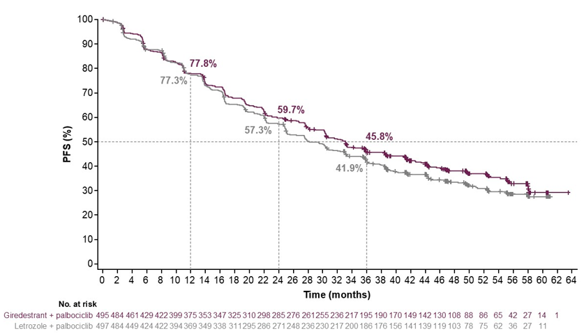
presevERA: PFS
 | Giredestrant + palbociclib n = 495 | Letrozole + palbociclib n = 497
Events, n (%) | 300 (60.6) | 323 (65.0)
Median, months (95% Cl) | 33.1 (30.2-38.3) | 28.2 (25.0-33.1)
Stratified HR (95% Cl): 0.89 (0.76-1.05); P = 0.1553
Median follow-up
Giredestrant arm: 52.2 months (range: 0.4-63.5)
Letrozole arm: 52.1 months (range: 0.3-62.6)
Notes:
The hazard ratio (HR) for INV-PFS was 0.89 (95% confidence interval [CI] = 0.76, 1.05; p = 0.1553); median INV-PFS was 33.1 mo with GIRE + PALBO vs 28.2 mo with LET + PALBO (Δ 4.9 mo).

Slide 48
Phase 3 SERENA-4: Study Design
ET sensitive breast cancer in 1L
ER+/HER2- LA/ABC
No prior systemic tx
for ABC
N = 1,342
Camizestrant 75 mg QD
Palbociclib 125 mg
Anastrozole-matched PLA
PFS
R
1:1
Anastrozole 1 mg
Palbociclib 125 mg
Camizestrant-matched PLA
Did not meet primary objective of statistically significant improvement in PFS, however, a numerical improvement was observed
Notes:
SERENA-4 will enroll 1,342 patients with de novo or recurrent ER+ HER2– ABC who have not previously received systemic treatment for their locoregionally recurrent or metastatic disease. Patients with recurrent disease must have received adjuvant AI or tamoxifen therapy for at least 24 months without relapse. Patients will be randomized 1:1 to receive orally either (a) AZD9833 (75 mg, once daily), palbociclib (125 mg, once daily for 21 days followed by 7 days off treatment) and anastrozole-matching placebo (once daily) or (b) anastrozole (1 mg, once daily), palbociclib (same as active arm), and AZD9833-matching placebo (once daily). Premenopausal women and men will also receive LHRH agonists. The primary endpoint will be progression-free survival (PFS; up to 5 years). Secondary endpoints will include overall survival (up to 8 years), length of second PFS period, objective response, time to chemotherapy, and changes in QoL measures. Enrollment began in January 2021.
SERENA-4 trial did not meet primary objective of statistically significant improvement in progression-free survival, however a numerical improvement was observed.
https://www.astrazeneca.com/media-centre/press-releases/2026/update-serena-4-phase-iii-trial.html

Slide 49
Phase 3 pioNERA: Study Design
ET resistant breast cancer in 1L
Resistance to prior adjuvant ET
Prior use of neo/adjuvant CDK4/6i allowed
Giredestrant +
CDK4/6i
Primary Endpoint: PFS in ESR1m subgroup and full analysis set
Secondary Endpoints: PFS in the ESR1nmd subgroup, OS, cORR, DoR, CBR, time to chemotherapy, TTCD in PROs, AEs, vital sign and clinical laboratory test abnormalities
PD, unacceptable toxicity, or loss of clinical benefit
Fulvestrant +
CDK4/6i
Notes:
pionERA BC (NCT06065748) is a Phase III, global, randomized, open-label, multicenter study in pts with ER+, HER2– LA/mBC with resistance to prior adj ET. Pts will be randomized 1:1 to oral daily 30 mg giredestrant or IM 500 mg fulvestrant (Days 1 and 15 of Cycle 1, then once monthly), both in combination with inv’s choice of CDK4/6i (palbociclib, abemaciclib, or ribociclib), stratified by: prior adj CDK4/6i (yes vs. no); choice of CDK4/6i; ESR1m status by central testing (ESR1m vs. no ESR1 mutation detected [ESR1nmd]); disease site (visceral vs. non-visceral). Pts will receive tx until disease progression, limiting toxicity, death, or consent withdrawal. Eligibility: Female/male pts with ER+, HER2– LA/mBC; resistance to prior adj ET (± CDK4/6i); no prior systemic tx for LA/mBC; documented ESR1m status by circulating tumor DNA. Enrollment of pts with ESR1nmd tumors will be capped at 60% of the total study population. Co-primary endpoints (EPs): Inv-assessed progression-free survival (PFS) in the ESR1m subgroup and in the full analysis set. Secondary EPs: PFS (ESR1nmd subgroup); overall survival (OS); inv-assessed confirmed overall response rate; duration of response; clinical benefit rate; time to chemotherapy; safety; pt-reported outcomes. The co-primary EPs will be compared between tx arms using a stratified log-rank test at an overall 0.05 significance level (two-sided). An interim OS analysis is planned at the time of the primary PFS analysis; an independent data monitoring committee will be in place for safety. Target enrollment: 1050 pts.

Slide 50
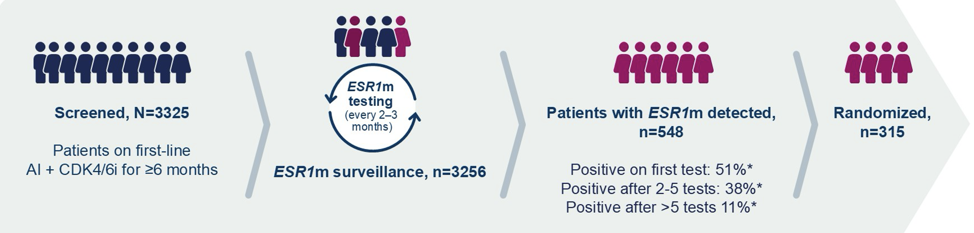
Phase 3 SERENA-6 Trial: Study Design
Adult patients with
ER+/HER2– ABC
All patients had received AI + CDK4/6i (palbociclib, ribociclib, or abemaciclib) as initial endocrine-based therapy for ABC for at least 6 months
ESR1m detected in ctDNA with no evidence of disease progression
Camizestrant (75 mg QD) +
continuing CDK4/6i + placebo for AI
Primary endpoint
PFS by investigator assessment (RECIST v1.1)
Secondary endpoints
﻿﻿PFS2
﻿﻿OS
﻿﻿Safety
﻿﻿Patient-reported outcomes
R 1:1
Stratification factors
﻿﻿Visceral vs non-visceral
﻿﻿ESR1m detection at first test vs at a subsequent test
﻿﻿Time from initiation of Al + CDK4/6i to randomization:
<18 vs ≥18 months
﻿﻿Palbociclib vs ribociclib vs abemaciclib
N = 315
Continuing AI (anastrozole/letrozole) +
CDK4/6i +placebo for camizestrant
Turner NC, et al. ASCO 2025. Abstract LBA4. Bidard FC, et al. N Engl J Med. 2025;393(6):569-580.
Notes:
The SERENA-6 trial tested patients with advanced breast cancer with ER-positive, human epidermal growth factor receptor 2 (HER2)–negative tumors for ESR1 mutations in circulating tumor DNA (ctDNA) once every 2 to 3 months. All the patients had received at least 6 months of first-line therapy with an aromatase inhibitor plus a CDK4/6 inhibitor (palbociclib, ribociclib, or abemaciclib). Patients who were found to have an ESR1 mutation and did not have radiologic progression were assigned in a 1:1 ratio to switch to camizestrant (75 mg once daily) with a continued CDK4/6 inhibitor plus placebo in place of an aromatase inhibitor or to continue to receive an aromatase inhibitor plus a CDK4/6 inhibitor plus placebo in place of camizestrant. The primary outcome was investigator-assessed progression-free survival.
A total of 3256 patients were tested for an ESR1 mutation. The 315 eligible patients were assigned to switch to camizestrant (157 patients) or to continue to receive an aromatase inhibitor (158 patients).

Slide 51
Phase 3 SERENA-6 Trial: Study Design (cont’d)
Adult patients with ER+/HER2– ABC
All patients had received AI + CDK4/6i (palbociclib, ribociclib, or abemaciclib) as initial endocrine-based therapy for ABC for at least 6 months
ESR1m detected in ctDNA with no evidence of disease progression
≤1 prior line of chemotherapy for ABC
Camizestrant (75 mg QD) +
continuing CDK4/6i + placebo for AI (n = 157)*
The study was powered
for PFS (primary endpoint)
and the key secondary endpoint of investigator-
assessed PFS2
R 1:1
Treatment continued until disease
progression, unacceptable toxicity, patient
withdrawal, or death
N = 315
Continuing AI + CDK4/6i +
placebo for camizestrant (n = 158)*
Randomization
First PD or death
Second PD or death
PFS
PFS2†
RECIST v1.1 tumor
assessment
Every 8 weeks for 18 months and then
every 12 weeks (RECIST mandatory)
Every 8-12 weeks
(RECIST recommended)
Median time before a patient required cytotoxic chemotherapy or an ADC:
22.6 months with camizestrant vs 18.7 months with an AI (HR, 0.64)
Notes:
CAMI + CDK4/6i prolonged chemotherapy/ADC-free survival (HR: 0.64 [95% CI: 0.47–0.87]; nominal P=0.00375) and TTD in GHS/QoL (0.48 [0.31–0.76]); nominal P<0.001).

Slide 52
SERENA-6: Investigator-Assessed PFS (Primary Endpoint)
Median time to ESR1m detection: 22 months
 | Camizestrant + CDK4/6i (N=157) | AI + CDK4/6i (N=158)
PFS events | 71 | 100
Median PFS (95% CI); months | 16.0 (12.7–18.2) | 9.2 (7.2–9.5)
Adjusted HR (95% CI): 0.44 (0.31–0.60); P < 0.0001
100
90
80
70
AI + CDK4/6i
60.7%
60
Camizestrant + CDK4/6i
PFS (%)
50
40
29.7%
30
33.4%
20
10
5.4%
0
 | 0 | 3 | 6 | 9 | 12 | 15 | 18 | 21 | 24 | 27 | 30 | 33
 | Time from randomization (months)
Number of patients at risk
Camizestrant + CDK4/6i | 157 | 138 | 105 | 82 | 55 | 41 | 26 | 11 | 9 | 7 | 6 | 0
AI + CDK4/6i | 158 | 124 | 73 | 55 | 29 | 17 | 7 | 3 | 1 | 0 | 0 | 0
Notes:
At an interim analysis at a median follow-up of 12.6 months, the median progression-free survival was 16.0 months (95% confidence interval [CI], 12.7 to 18.2) in the camizestrant group and 9.2 months (95% CI, 7.2 to 9.5) in the aromatase-inhibitor group (hazard ratio for progression or death, 0.44; 95% CI, 0.31 to 0.60; P<0.0001).

Slide 53
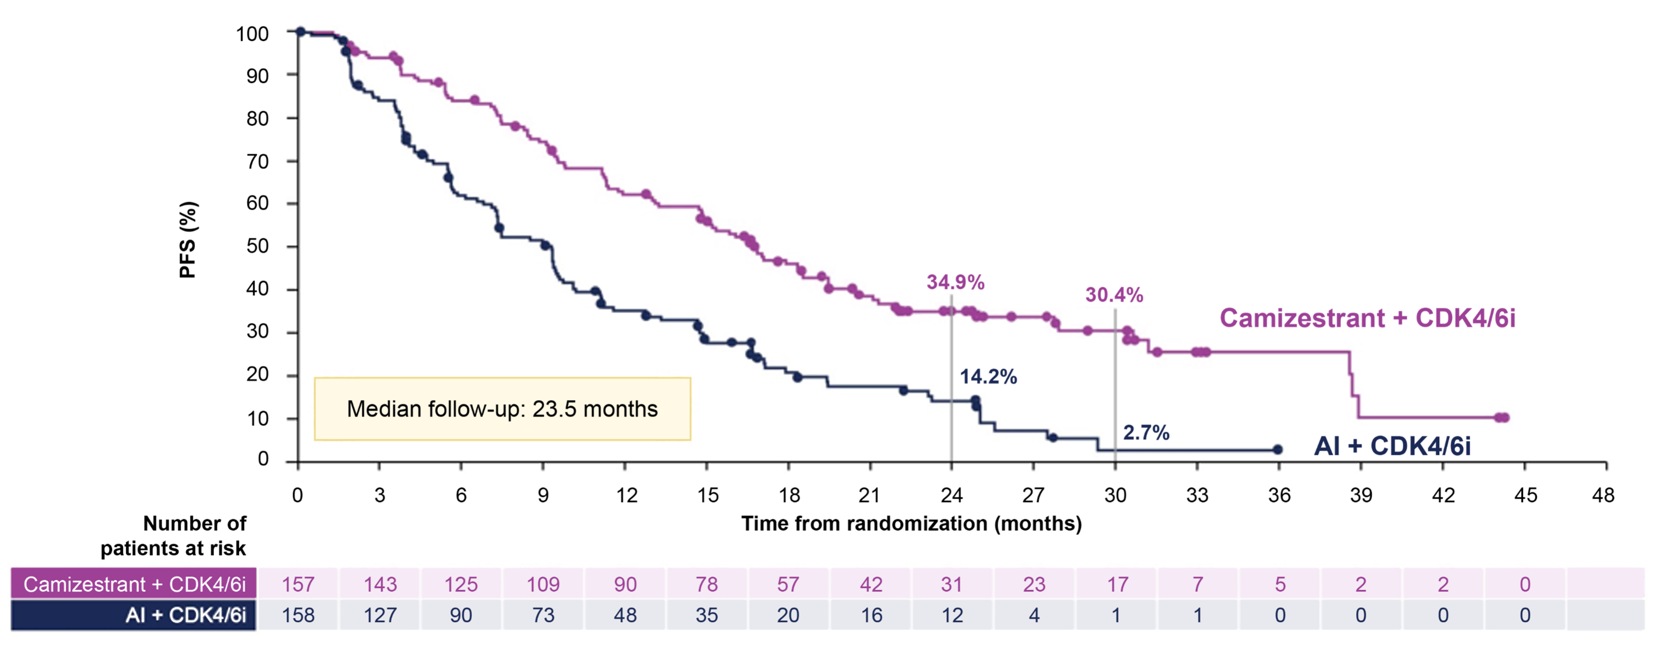
SERENA-6: PFS
 | Camizestrant + CDK4/6i (n = 157) | AI + CDK4/6i (n = 158)
Events, n (%) | 99 (63.1) | 124 (78.5)
Median PFS (95% Cl); months | 16.8 (14.7-9.4) | 9.2 (7.2-9.7)
HR (95% Cl): 0.45 (0.34-0.59); nominal P < 0.00001
FDA granted accelerated approval
Notes:
PFS benefit with CAMI + CDK4/6i was maintained with longer follow-up); 30-mo PFS rate was 30.4% vs 2.7% with continued AI + CDK4/6i. PFS benefit was not impacted by common co-mutations (PIK3CA in 41.3% of pts, HR: 0.44 [95% CI: 0.28–0.68]; TP53 in 25.4% of pts, 0.49 [0.30–0.82]). At 30% maturity, OS HR was 0.87 (0.57–1.30).
FDA accelerated approval: https://www.fda.gov/drugs/resources-information-approved-drugs/fda-grants-accelerated-approval-camizestrant-cdk46-inhibitor-esr1-mutated-hr-positive-her2-negative

Slide 54
SERENA-6: Final PFS2
 | Camizestrant + CDK4/6i (n = 157) | AI + CDK4/6i (n = 158)
Events, n (%) | 80 (51.0) | 90 (57.0)
Median PFS (95% Cl); months | 25.7 (20.4-30.3) | 19.1 (16.8-21.0)
HR (95% Cl): 0.63 (0.46-0.86); P = 0.00373
Notes:
Pts had scans to assess PFS2 every 8–12 weeks after first progression. PFS2 analysis was planned after ~158 PFS2 events (77% power to detect HR of 0.65) and analyzed using an adjusted log-rank test and a 2-sided significance level of ~5%. Chemotherapy/ADC-free survival was a secondary endpoint.
After 23.5 mo median follow-up (data cutoff: Jan 3, 2026), median PFS2 was 25.7 mo with CAMI + CDK4/6i vs 19.1 mo with AI + CDK4/6i; statistically significant improvement, HR: 0.63 (95% CI: 0.46–0.86); P=0.00373
This demonstrates that the benefit of intervening early with camizestrant is sustained even after the first subsequent line of therapy.

Slide 55
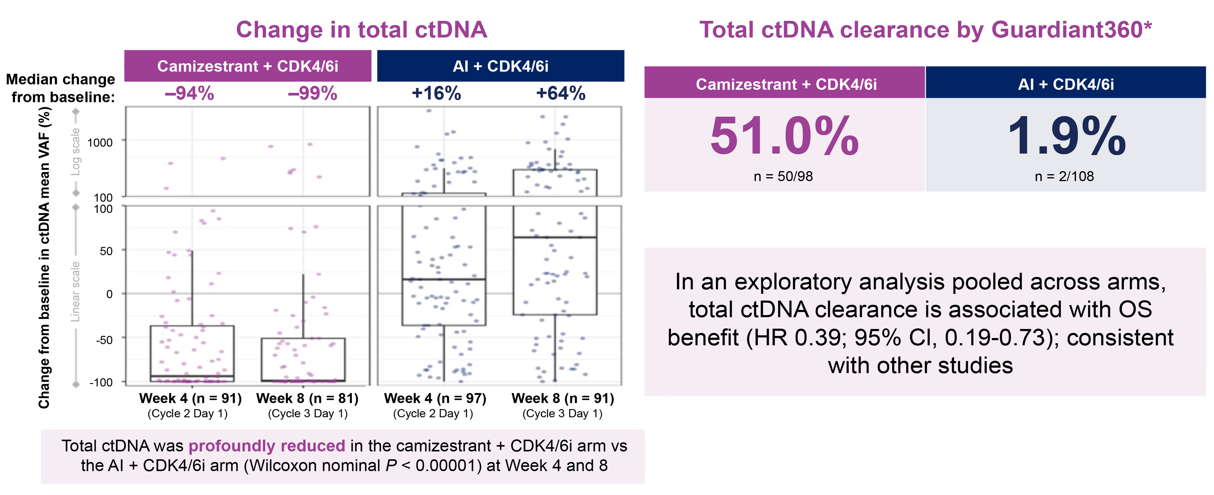
SERENA-6: Total ctDNA Dynamics on Treatment

Slide 56
When Should We Check ctDNA Levels?
Based on the SERENA-6 ctDNA findings, quarterly ctDNA assessment may be a practical approach
Because most clinicians obtain imaging every 3 months, ctDNA testing can be ordered ~2 weeks before scheduled scans to allow time for results
Imaging and ctDNA results can then be reviewed with patients to inform ongoing treatment decisions

Slide 57
Discussion:
Future ESR1 Monitoring in First-Line
Prospective ctDNA surveillance during first-line ET + CDK4/6i
Detection of
emergent ESR1 mutations early to inform ongoing treatment strategies

Slide 58
Trials of Elacestrant in Progress
ADELA (NCT06382948): A double-blind, placebo-controlled, randomized phase 3 trial of elacestrant (Ela) + everolimus (EVE) versus elacestrant + placebo in ER+/HER2− aBC patients with ESR1-mutated tumors progressing on endocrine therapy (ET) + CDK4/6i¹
CAPELA (NCT07222215): A phase 2, multicenter, open-label, randomized study of capecitabine in combination with elacestrant versus capecitabine alone in advanced ER–positive breast cancer (TBCRC 070)²
ELECTRA (NCT05386108): An open-label, multicenter, phase 1b/2 study of elacestrant in combination with abemaciclib in patients with brain metastasis from ER+/HER2− breast cancer³
ELEGANT (NCT06492616): Elacestrant versus standard ET in women and men with node-positive, ER+, HER2−,
eBC with high risk of recurrence in a global, multicenter, randomized, open-label phase 3 study⁴

Slide 59
TOMORROW: Integrating Emerging Oral SERDs, PROTACS, Combination Data, and Evidence-Based Sequencing
Sequencing Frameworks for Oral SERDs, PROTACs, and Targeted Therapies

Slide 60
VIKTORIA-1 Study 1 (PIK3CA-WT)
HR+
/
HE
R2
-
Ar
m
A
†
Ad
v
a
n
c
e
d
Br
e
a
s
t
C
a
n
c
e
r
Ge
d
a
t
o
l
i
s
i
b
180
mg
I
V
onc
e
week
l
y
,
Pr
i
m
a
r
y
En
d
p
o
i
n
t
s
3
week
s
on,
1
week
of
f
El
i
g
i
b
i
l
i
t
y
C
r
i
t
e
r
i
a
Pa
l
b
o
c
i
c
l
i
b
125
mg
dai
l
y
,
PF
S
(
BI
CR)
21
day
s
on,
7
day
s
of
f
•
Pr
e
-
&
p
o
s
t
m
e
n
o
p
a
u
s
a
l
w
o
m
e
n
&
m
e
n
500
mg;
c
y
c
l
e
1,
day
s
1
&
15,
t
hen
Ar
m
A
v
s
.
Ar
m
C
•
Pr
o
g
r
e
s
s
i
o
n
o
n
/
a
f
t
e
r
C
D
K4
/
6
i
+
N
SAI
Ful
v
es
t
r
ant
ev
er
y
4
week
s
Ar
m
B
v
s
.
Ar
m
C
•
≤
2
lin
e
s
o
f
p
r
io
r
E
T
f
o
r
A
B
C
ST
UDY
1
R
1:
1:
1
Ar
m
B
†
PI
K3
CA
-
WT
(N
=
3
9
2
)
Ge
d
a
t
o
l
i
s
i
b
180
mg
I
V
onc
e
week
l
y
,
Se
c
o
n
d
a
r
y
En
d
p
o
i
n
t
s
•
Me
a
s
u
r
a
b
l
e
d
i
s
e
a
s
e
,
RE
CI
S
T
v
1
.
1
3
week
s
on,
1
week
of
f
•
Sc
r
e
e
n
i
n
g
r
e
s
u
l
t
f
o
r
PI
K3
C
A
st
a
t
u
s
Ful
v
es
t
r
ant
500
mg;
c
y
c
l
e
1,
day
s
1
&
15,
t
hen
OS
ev
er
y
4
week
s
Re
s
p
o
n
s
e
•
No
T
2
DM
wi
t
h
Hb
A
1
c
>
6
.
4
%
o
r
T
1
DM
Assign
Ar
m
C
Sa
f
e
t
y
•
No
p
r
i
o
r
mT
O
R
i
, P
I3
K
i
, o
r
AKT
i
Ful
v
es
t
r
ant
500
mg;
c
y
c
l
e
1,
day
s
1
&
15,
t
hen
Qo
L
ev
er
y
4
week
s
•
No
p
r
i
o
r
c
h
e
m
o
t
h
e
r
a
p
y
f
o
r
A
B
C
Op
ti
o
n
a
l
c
r
o
s
s
-
ov
e
r
t
o
A
r
m
A
or
B
a
t
pr
ogr
e
s
s
i
on
St
r
a
t
i
f
i
c
a
t
i
o
n
F
a
c
t
o
r
s
•
Lung/
l
i
v
er
m
et
as
t
as
es
(y
es
/
no)
Ge
d
a
t
o
l
i
s
i
b
†
+
P
a
l
b
o
c
i
c
l
i
b
+
F
u
l
v
e
s
t
r
a
n
t
•
Ti
m
e
t
o
progres
s
i
on
on
i
m
m
edi
at
e
pri
or
ST
UDY
2
R
3:
3:
1
Ge
d
a
t
o
l
i
s
i
b
†
+
Fu
l
v
e
s
t
r
a
n
t
th
e
r
a
p
y
(
≤
or
>
6
m
ont
hs
)
PI
K3
CA
-
MT
Al
p
e
l
i
s
i
b
+
F
u
l
v
e
s
t
r
a
n
t
•
Re
g
i
o
n
(
US
/
Ca
n
a
d
a
or
R
O
W
)
†
Pr
ophy
l
ac
t
i
c
us
e
of
a
s
t
er
oi
d
-
co
n
t
a
i
n
i
n
g
“
swi
sh
a
n
d
sp
i
t
”
r
e
g
i
m
e
n
wa
s
p
r
o
t
o
co
l
-
ma
n
d
a
t
e
d
;
or
al
non
-
se
d
a
t
i
n
g
a
n
t
i
h
i
st
a
m
i
n
e
t
h
e
r
a
p
y
wa
s
r
e
co
m
m
e
n
d
e
d

Slide 61
1st Co-Primary Endpoint: Progression-Free Survival
Gedatolisib Triplet vs. Fulvestrant, BICR Assessment
100
Geda + Palbo +
Fulvestrant
(n=131)
Fulvestrant
(n=131)
90
80
Median PFS, months (95% CI) | 9.3 (7.2-16.6) | 2.0 (1.8-2.3)
Adjusted HR (95% CI) | 0.24 (0.17-0.35); P < 0.0001
Progression-free Survival (%)
70
60
50
40
30
20
10
0
0
1
2
3
4
5
6
7
8
9
10
11
12
13
14
15
16
17
18
19
20
21
22
23
24
Months
No. at Risk:
Geda + Palbo + Fulv | 131 | 127 | 103 | 94 | 69 | 68 | 50 | 49 | 35 | 34 | 24 | 22 | 19 | 16 | 10 | 10 | 9 | 6 | 6 | 6 | 4 | 4 | 4 | 1 | 0
Fulv | 131 | 114 | 45 | 35 | 20 | 20 | 11 | 11 | 7 | 5 | 3 | 2 | 2 | 2 | 1 | 1 | 1 | 0

Slide 62
2nd Co-Primary Endpoint: Progression-Free Survival
Gedatolisib Doublet vs. Fulvestrant, BICR Assessment
100
Gedatolisib +
Fulvestrant
(n=130)
Fulvestrant
(n=131)
90
80
Median PFS, months (95% CI) | 7.4 (5.5-9.9) | 2.0 (1.8-2.3)
Adjusted HR (95% CI) | 0.33 (0.24-0.48); P < 0.0001
Progression-free Survival (%)
70
60
50
40
30
20
10
0
0
1
2
3
4
5
6
7
8
9
10
11
12
13
14
15
16
17
18
19
20
21
22
23
24
25
26
Months
No. at Risk:
Geda + Fulv | 130 | 126 | 93 | 89 | 64 | 63 | 45 | 44 | 33 | 33 | 22 | 22 | 17 | 16 | 11 | 8 | 6 | 5 | 5 | 3 | 1 | 1 | 1 | 1 | 1 | 1 | 0
Fulv | 131 | 114 | 45 | 35 | 20 | 20 | 11 | 11 | 7 | 5 | 3 | 2 | 2 | 2 | 1 | 1 | 1 | 0

Slide 63
VIKTORIA-1 Study 1: Safety and Tolerability
Treatment-Related Adverse Events (Safety Population)*
SAE and discontinuation, n (%) | Gedatolisib + palbociclib + fulvestrant (n=130) |  |  | Gedatolisib + fulvestrant (n=130) |  |  | Fulvestrant (n=123)
Pts with ≥1 SAE | 14 (10.8) |  |  | 12 (9.2) |  |  | 1 (0.8)
Study treatment D/C due to TRAE | 3 (2.3) |  |  | 4 (3.1) |  |  | 0
Deaths due to TRAE† | 2 (1.5) |  |  | 0 |  |  | 0
Adverse events, n (%) | Gedatolisib + palbociclib + fulvestrant (n=130) |  |  | Gedatolisib + fulvestrant (n=130) |  |  | Fulvestrant (n=123)
 | Any Grade | Grade 3 | Grade 4 | Any Grade | Grade 3 | Grade 4 | Any Grade | Grade 3 | Grade 4
Stomatitis‡ | 90 (69.2) | 25 (19.2) | 0 | 74 (56.9) | 16 (12.3) | 0 | 0 | 0 | 0
Neutropenia‡ | 85 (65.4) | 68 (52.3) | 13 (10.0) | 2 (1.5) | 0 | 1 (0.8) | 1 (0.8) | 1 (0.8) | 0
Nausea | 57 (43.8) | 5 (3.8) | 0 | 56 (43.1) | 1 (0.8) | 0 | 4 (3.3) | 0 | 0
Rash‡ | 36 (27.7) | 6 (4.6) | 0 | 42 (32.3) | 7 (5.4) | 0 | 0 | 0 | 0
Vomiting | 36 (27.7) | 2 (1.5) | 0 | 30 (23.1) | 0 | 0 | 1 (0.8) | 0 | 0
Fatigue | 29 (22.3) | 2 (1.5) | 0 | 27 (20.8) | 1 (0.8) | 0 | 5 (4.1) | 0 | 0
Diarrhea§ | 22 (16.9) | 2 (1.5) | 0 | 16 (12.3) | 1 (0.8) | 0 | 0 | 0 | 0
Hyperglycemia‡,§ | 12 (9.2) | 3 (2.3) | 0 | 15 (11.5) | 3 (2.3) | 0 | 0 | 0 | 0

Slide 64
CAPItello-291: Study Overview
Phase III, randomized, double-blind, placebo-controlled study (NCT04305496)
Capivasertib
Patients with HR+/HER2*– ABC
400 mg twice daily,
4 days on, 3 days off
Dual primary endpoints
Dual primary endpoints
PFS by investigator assessment
Overall population
AKT pathway-altered tumours
(≥1 qualifying PIK3CA, AKT1, or PTEN alteration)
Fulvestrant
PFS by investigator assessment
Overall
AKT pathway-altered tumours (≥1 qualifying PIK3CA, AKT1, or PTEN alteration)
Men and pre-/post-menopausal women
Recurrence or progression while on, or <12 months from end of, adjuvant AI, or progression while on prior AI for ABC
≤2 lines of prior endocrine therapy for ABC
≤1 line of chemotherapy for ABC
Prior CDK4/6 inhibitors allowed (at least 51% required)
No prior SERD, mTOR inhibitor, PI3K inhibitor, or AKT inhibitor
HbA1c <8.0% (63.9 mmol/mol) and diabetes not requiring insulin allowed
FFPE tumor sample from the primary/recurrent cancer available for retrospective central molecular testing
500 mg: Cycle 1, Days 1 & 15; then every 4 weeks
R1:1
(N=708)
Stratification factors:
Liver metastases (yes/no)
Prior CDK4/6 inhibitor (yes/no)
Region†
Preplanned exploratory PFS analyses
Preplanned exploratory PFS analyses
Placebo
Subgroups: prior use of CDK4/6 inhibitor (yes/no), prior chemotherapy for ABC (yes/no) and presence of liver metastases at baseline (yes/no)
Overall
AKT pathway-altered tumours
Subgroups: prior use of CDK4/6 inhibitor (yes/no), prior chemotherapy for ABC (yes/no) and presence of liver metastases at baseline (yes/no)
Overall
AKT pathway-altered tumours
Twice daily,
4 days on, 3 days off
Fulvestrant
500 mg: Cycle 1, Days 1 & 15; then every 4 weeks

Slide 65
Dual Primary Endpoint: PFS in Overall and AKT Pathway-Altered Populations
Capivasertib plus fulvestrant provides a statistically significant and clinically meaningful improvement in PFS in the overall and the AKT pathway-altered populations
Overall population
AKT pathway-altered population
100
100
 | Capivasertib + fulvestrant (N=355) | Placebo + fulvestrant (N=353)
Events | 258 | 293
Median (95% CI); months | 7.2 (5.5–7.4) | 3.6 (2.8–3.7)
Adjusted HR (95% CI): 0.60 (0.51–0.71) | 0.60 (0.48, 0.76)
 | Capivasertib + fulvestrant (N=155) | Placebo + fulvestrant (N=134)
Events | 121 | 115
Median (95% CI); months | 7.3 (5.5–9.0) | 3.1 (2.0–3.7)
Adjusted HR (95% CI): 0.50 (0.38–0.65) | 0.60 (0.48, 0.76)
90
90
80
80
70
70
60
60
Progression-free survival (%)
50
50
40
40
30
30
20
20
10
10
0
0
Number of patients at risk | 0 | 2 | 4 | 6 | 8 | 10 | 12 | 14 | 16 | 18 | 20 | 22 | 24 | 26
Number of patients at risk | Time from randomisation (months)
Capivasertib + fulvestrant | 355 | 226 | 207 | 172 | 138 | 115 | 78 | 55 | 43 | 25 | 8 | 5 | 2 | 0
Placebo + fulvestrant | 353 | 207 | 142 | 106 | 83 | 66 | 51 | 33 | 23 | 11 | 4 | 3 | 1 | 0
0 | 2 | 4 | 6 | 8 | 10 | 12 | 14 | 16 | 18 | 20 | 22 | 24 | 26
Time from randomisation (months)
155 | 127 | 99 | 80 | 65 | 54 | 38 | 26 | 21 | 12 | 3 | 2 | 1 | 0
134 | 77 | 48 | 37 | 28 | 24 | 17 | 11 | 6 | 2 | 1 | 1 | 0 | 0

Slide 66
VIKTORIA-1 Study 2 (PIK3CA-mutant)
HR+
/
HE
R2
-
Ar
m
D*
Ad
v
a
n
c
e
d
Br
e
a
s
t
C
a
n
c
e
r
Ge
d
a
t
o
l
i
s
i
b
180
mg
I
V
onc
e
week
l
y
,
Pr
i
m
a
r
y
En
d
p
o
i
n
t
s
3
week
s
on,
1
week
of
f
El
i
g
i
b
i
l
i
t
y
C
r
i
t
e
r
i
a
Pa
l
b
o
c
i
c
l
i
b
125
mg
dai
l
y
,
21
day
s
on,
7
day
s
of
f
PFS (BICR)
Arm D vs. Arm E
•
Pr
e
-
&
p
o
s
t
m
e
n
o
p
a
u
s
a
l
w
o
m
e
n
&
m
e
n
500
mg;
c
y
c
l
e
1,
day
s
1
&
15,
t
hen
•
Pr
o
g
r
e
s
s
i
o
n
o
n
/
a
f
t
e
r
C
D
K4
/
6
i
+
N
SAI
Ful
v
es
t
r
ant
ev
er
y
4
week
s
•
≤
2
lin
e
s
o
f
p
r
io
r
E
T
f
o
r
A
B
C
ST
UDY
2
R
3:
3:
1
Ar
m
E
PI
K3
CA
-
MT
(N
=
3
6
2
)
Alpelisib
300 mg orally daily for 4 weeks
Se
c
o
n
d
a
r
y
En
d
p
o
i
n
t
s
•
Me
a
s
u
r
a
b
l
e
d
i
s
e
a
s
e
,
RE
CI
S
T
v
1
.
1
•
Sc
r
e
e
n
i
n
g
r
e
s
u
l
t
f
o
r
PI
K3
C
A
st
a
t
u
s
Ful
v
es
t
r
ant
500
mg;
c
y
c
l
e
1,
day
s
1
&
15,
t
hen
OS
PFS (BICR F vs. E)
Response
Safety
QoL
ev
er
y
4
week
s
•
No
T
2
DM
wi
t
h
Hb
A
1
c
>
6
.
4
%
o
r
T
1
DM
Assign
Ar
m
F*
•
No
p
r
i
o
r
mT
O
R
i
, P
I3
K
i
, o
r
AKT
i
Ge
d
a
t
o
l
i
s
i
b
180
mg
I
V
onc
e
week
l
y
,
3
week
s
on,
1
week
of
f
•
No
p
r
i
o
r
c
h
e
m
o
t
h
e
r
a
p
y
f
o
r
A
B
C
500
mg;
c
y
c
l
e
1,
day
s
1
&
15,
t
hen
St
r
a
t
i
f
i
c
a
t
i
o
n
F
a
c
t
o
r
s
Ful
v
es
t
r
ant
ev
er
y
4
week
s
•
Lung/
l
i
v
er
m
et
as
t
as
es
(y
es
/
no)
Arm A
Ge
d
a
t
o
l
i
s
i
b
†
+
P
a
l
b
o
c
i
c
l
i
b
+
F
u
l
v
e
s
t
r
a
n
t
•
Ti
m
e
t
o
progres
s
i
on
on
i
m
m
edi
at
e
pri
or
ST
UDY
1
th
e
r
a
p
y
(
≤
or
>
6
m
ont
hs
)
PI
K3
CA
-
WT
R
1:
1:
1
Arm B
Ge
d
a
t
o
l
i
s
i
b
†
+
Fu
l
v
e
s
t
r
a
n
t
•
Re
g
i
o
n
(
US
/
Ca
n
a
d
a
or
R
O
W
)
Arm C
Al
p
e
l
i
s
i
b
+
F
u
l
v
e
s
t
r
a
n
t
†
Pr
ophy
l
ac
t
i
c
us
e
of
a
s
t
er
oi
d
-
co
n
t
a
i
n
i
n
g
“
swi
sh
a
n
d
sp
i
t
”
r
e
g
i
m
e
n
wa
s
p
r
o
t
o
co
l
-
ma
n
d
a
t
e
d
;
or
al
non
-
se
d
a
t
i
n
g
a
n
t
i
h
i
st
a
m
i
n
e
t
h
e
r
a
p
y
wa
s
r
e
co
m
m
e
n
d
e
d

Slide 67
Primary Endpoint: Progression-Free Survival (BICR)
Gedatolisib Triplet vs. Alpelisib + Fulvestrant in VIKTORIA-1 Study 2

Slide 68
Secondary Endpoint: Progression-Free Survival (BICR)
Gedatolisib Doublet vs. Alpelisib + Fulvestrant in VIKTORIA-1 Study 2

Slide 69
VIKTORIA-1 Study 2: PIK3CAm Toxicity
Exposure | Arm D: Gedatolisib + Palbociclib + Fulvestrant (n=153) |  |  | Arm F: Gedatolisib + Fulvestrant (n=52) |  |  | Arm E: Alpelisib + Fulvestrant (n=152)
Median RDI, Geda (IQR) | 93.3 (80.6-100) |  |  | 100 (97.8-100) |  |  | --
Median RDI, Alpe (IQR) | -- |  |  | -- |  |  | 81.7 (64.8-96.2)
TRAE and TR-SAE, n (%)
Pts with ≥1 TRAE | 150 (98.0) |  |  | 50 (96.2) |  |  | 147 (96.7)
Study tx D/C for TRAE | 4 (2.6) |  |  | 2 (3.8) |  |  | 11 (7.1)
Pts with ≥1 TR-SAE | 16 (10.5) |  |  | 2 (3.8) |  |  | 20 (13.2)
Deaths due to TR-SAE* | 1 (0.7) |  |  | 0 |  |  | 2 (1.3)
Adverse events, n (%)† | Any Grade | Grade 3 | Grade 4 | Any Grade | Grade 3 | Grade 4 | Any Grade | Grade 3 | Grade 4
Neutropenia‡ | 97 (63.4) | 73 (47.7) | 17 (11.1) | 1 (1.9) | 0 | 0 | 2 (1.3) | 0 | 1 (0.7)
Stomatitis‡ | 94 (61.4) | 25 (16.3) | 0 | 32 (61.5) | 3 (5.8) | 0 | 52 (34.2) | 8 (5.3) | 0
Nausea | 70 (45.8) | 5 (3.3) | 0 | 21 (40.4) | 1 (1.9) | 0 | 50 (32.9) | 2 (1.3) | 0
Rash‡ | 40 (26.1) | 20 (6.5) | 0 | 17 (32.7) | 3 (5.8) | 0 | 56 (36.8) | 23 (15.1) | 0
Vomiting | 39 (25.5) | 0 | 0 | 10 (19.2) | 0 | 0 | 23 (15.1) | 1 (0.7) | 0
Fatigue | 33 (21.6) | 5 (3.3) | 0 | 11 (21.2) | 1 (1.9) | 0 | 32 (21.1) | 4 (2.6) | 0
Diarrhea§ | 23 (15.0) | 2 (1.3) | 0 | 5 (9.6) | 0 | 0 | 61 (40.1) | 9 (5.9) | 1 (0.7)
Hyperglycemia‡,§ | 23 (15.0) | 4 (2.6) | 0 | 6 (11.5) | 0 | 0 | 88 (57.9) | 21 (13.8) | 1 (0.7)
*Grade 5 events include fatal cerebral hemorrhage (gedatolisib triplet), urosepsis (alpelisib + fulvestrant group), and general physical health decline (alpelisib + fulvestrant group)
†Shown are adverse events of any grade that occurred in at least 20% of the patients in any trial group unless otherwise noted
‡For stomatitis, neutropenia, rash, and hyperglycemia, combined preferred terms are used in the table; if a patient experienced multiple terms, it was counted once for the highest grade.
§Additional events of clinical importance

Slide 70
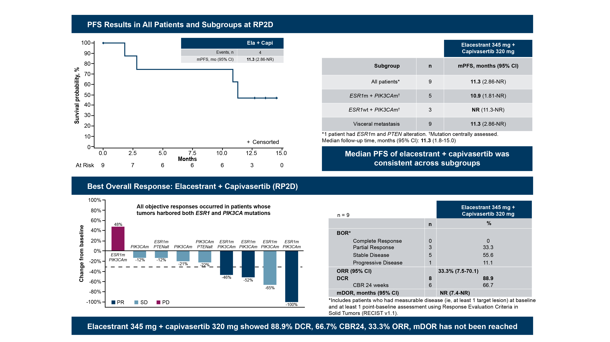
Phase 1/2 ELEVATE Trial: Efficacy Results for Elacestrant + Capivasertib (N = 60)
PFS Results in All Patients and Subgroups at RP2D
Best Overall Response: Elacestrant + Capivasertib (RP2D)
McHayleh W, et al. ASCO 2026. Abstract 1098.
Elecestrant 345 mg + capivasertib 320 mg showed 88.9% DCR, 66.7% CBR24, 33.3% ORR, mDOR has not been reached

Slide 71
ELEVATE: Most Common (>25%) TEAEs With Elacestrant + Capivasertib
Cohort 1 (n = 7) | Cohort 2 (RP2D) (n = 9) | Cohort 3 (n = 15) | Phase 1b (N = 31)
 | Elacestrant 258 mg + Capivasertib 320 mg |  | Elacestrant 345 mg + Capivasertib 320 mg |  | Elacestrant 345 mg + Capivasertib 400 mg |  | Elacestrant 258-345 mg + Capivasertib 320-400 mg
Preferred Term, n (%) | All Grades | Grade 3/4 | All Grades | Grade 3/4 | All Grades | Grade 3/4 | All Grades | Grade 3/4
Diarrhea | 5 (71) | 1 (14) | 8 (89) | 1 (11) | 12 (80) | 0 | 25 (81) | 2 (6)
Fatigue† | 4 (57) | 0 | 6 (67) | 1 (11) | 7 (47) | 0 | 17 (55) | 1 (3)
Nausea | 5 (71) | 0 | 6 (67) | 0 | 12 (80) | 0 | 23 (74) | 0
Rash‡ | 3 (43) | 0 | 6 (67) | 0 | 11 (73) | 4 (27) | 20 (65) | 4 (13)
Vomiting | 3 (43) | 0 | 3 (33) | 0 | 7 (47) | 0 | 13 (42) | 0
Decreased appetite | 2 (29) | 0 | 3 (33) | 0 | 4 (27) | 0 | 9 (29) | 0
Hyperglycemia§ | 2 (29) | 0 | 1 (11) | 0 | 7 (47) | 3 (20) | 10 (32) | 3 (10)

Slide 72
Roadmap for HR+/HER2− MBC Treatment in Clinic Today
Newly Diagnosed Metastatic HR+/HER2− BC
1L:
AI/SERD + CDK4/6i
Inavolisib + Fulv + Palbo (PIK3CA mutant)
2L or 3L:
SERD + PI3Ki (PIK3CA mutant)
Oral SERD (ESR1 mutation)
ET + mTORi
ET + AKTi (PIK3CA/AKT/PTEN alteration)
SERD + CDK4/6i (ESR1m, ESR1wt)
ET
Gedatolisib + Fulv +/- Palbociclib (PI3Kwt)
1L-3L:
PARPi (g/somaticBRCA1/2, gPALB2+)
≥2L:
Larotrectinib/Entrectinib (NTRK fusion)
Pembrolizumab (MSI-H/dMMR, high TMB)
Selpercatinib (RET alterations)
1-3 Lines of Sequential Endocrine-Based/Targeted Therapy*
Sequential Single Agent Chemotherapy
HER2 Low
HER2 “Zero”
2L/3L Chemo: Trastuzumab Deruxtecan
in 1L and for HER2 ultralow
Sacituzumab Govitecan
Datopotamab
?
*Chemotherapy for
visceral crisis

Slide 73
Evolving Treatment Landscape of HR+ MBC
Genomics
1st line Rx
Genomics
2nd line Rx
3rd line Rx &
Beyond
F + abema
F + everolimus
F + geda ±palbo
WT
ET + CDK4/6i
WT
Elacestrant
Vepdegestrant
Imlunestrant ± abema
Gire + evero
Other ET
PARPi
Chemo/ADC
ET + CDK4/6i
ET + inavo + palbo
PIK3/AKT
ESR1mut
Camizestrant + CDK4/6i (ESR1mut)
F + capivasertib
F + alpelisib
F + geda ± palbo
PIK3/AKT/PTEN alt
24-27mo
5-12mo
24-32mo

Slide 74
Discussion: Sequencing Frameworks for Oral SERDs, PROTACs & Targeted Therapies
!
Building a practical algorithm
Prior CDK4/6i exposure
Duration of first-line therapy
ESR1 status
Visceral vs indolent disease
Comorbidities
Patient goals
Integrating oral SERDs and vepdegestrant into the mBC treatment landscape
Sequencing with PI3K/AKT/mTOR, PARP, and chemotherapy to improve outcomes
Toxicity considerations
Oral SERD monotherapy
PROTAC therapy
combination strategies

Slide 75
Case-Based Learning Lab
Apply Today & Anticipate Tomorrow

Slide 76
PATIENT CASE
58-YEAR-OLD
Case Description
ER+/HER2− de novo mBC to the bones and liver
Has progression in the liver on AI + ribociclib after 26 months
ctDNA testing was obtained at progression
Scenario 1: ESR1 Y537S detected on ctDNA (PI3K wild type)

Slide 77
Scenario 1
For this patient with an isolated ESR1 mutation, which of the following would you recommend?
Elacestrant
Imlunestrant
Vepdegestrant
Fulvestrant + everolimus
Imlunestrant + abemaciclib
Gedatolisib + fulvestrant ± palbociclib
Need more information/additional testing
Unsure

Slide 78
Scenario 1
For this patient with an isolated ESR1 mutation, which of the following would you recommend?
Elacestrant
Imlunestrant
Vepdegestrant
Fulvestrant + everolimus
Imlunestrant + abemaciclib
Gedatolisib + fulvestrant ± palbociclib
Need more information/additional testing
Unsure
Rationale:
Any monotherapy SERD/PROTAC would be appropriate given the duration on prior CDK4/6i and current approval.
Combination of imlunestrant + abemaciclib is also appropriate per efficacy and safety demonstrated in EMBER-3. This regimen is NCCN endorsed and now FDA-approved.

Slide 79
PATIENT CASE
58-YEAR-OLD
Scenario 1: Continued…
Patient was treated with imlunestrant + abemaciclib
Remained on therapy for 11 months at which time there was progression in the liver
Biopsy confirmed ER 80%, PR 65%, and HER2 1+
Otherwise, asymptomatic with normal LFTs

Slide 80
Scenario 1
What treatment will you recommend next?
Gedatolisib + fulvestrant ± palbociclib
Fulvestrant + everolimus
Capecitabine
Paclitaxel
Trastuzumab deruxtecan
Need more information/additional testing
Unsure

Slide 81
PATIENT CASE
58-YEAR-OLD
Case Description
ER+/HER2− de novo mBC to the bones and liver
Has progression in the liver on AI + ribociclib after 26 months
ctDNA testing was obtained at progression
Scenario 2: ESR1 D538G + PI3 E545K detected on ctDNA

Slide 82
Scenario 2
For the patient with concurrent ESR1 and PIK3CA mutations, which of the following would you recommend?
Elacestrant + capivasertib
Fulvestrant + alpelisib
Fulvestrant + everolimus
Fulvestrant + capivasertib
Imlunestrant + abemaciclib
Gedatolisib + fulvestrant ± palbociclib
Need more information/additional testing
Unsure

Slide 83
Scenario 2
For the patient with concurrent ESR1 and PIK3CA mutations, which of the following would you recommend?
Elacestrant + capivasertib
Fulvestrant + alpelisib
Fulvestrant + everolimus
Fulvestrant + capivasertib
Imlunestrant + abemaciclib
Gedatolisib + fulvestrant ± palbociclib
Need more information/additional testing
Unsure
Rationale:
No prospective data for sequencing available. Treatment decisions are made based on available subgroup analysis, prior therapies, duration of response of prior treatment, tumor burden, co-morbidities and patient preference.

Slide 84
PATIENT CASE
58-YEAR-OLD
Scenario 2: Continued…
Patient was treated with imlunestrant + abemaciclib
Remained on therapy for 7 months at which time there was progression in the liver
Biopsy confirmed ER 80%, PR 65%, and HER2 1+
Otherwise, asymptomatic with normal LFT’s

Slide 85
Scenario 2
What treatment will you recommend next?
Gedatolisib + fulvestrant ± palbociclib
Fulvestrant + everolimus
Capecitabine
Paclitaxel
Trastuzumab deruxtecan
Unsure

Slide 86
Case Discussion
Patient and disease characteristics that impact treatment decision/selection
Constructing an adherence and adverse event plan
“Who does what” across the team
  Ordering labs, symptom monitoring, patient education
How could recent/emerging oral SERD/PROTAC data alter the decision?
  Combination strategies: imlunestrant + abemaciclib in EMBER-3
  First-line treatment: camizestrant + CDK4/6 inhibitor in SERENA-6

Slide 87
Key Takeaways
TODAY
TOMORROW
Monotherapy SERD/PROTAC approved for ESR1m after progression on AI + CDK4/6i
  SERD: elacestrant (EMERALD trial)
  SERD: imlunestrant (EMBER-3 trial)
  PROTAC: vepdegestrant (VERITAC-2 trial)
Imlunestrant + abemaciclib, now FDA-approved (ESR1-mutated with disease progression following at least one line of endocrine therapy; EMBER-3 trial)
Camizestrant + CDK4/6 inhibitor, now FDA-approved (emergent ESR1 mutation during first-line therapy; SERENA-6 trial)
Choice of monotherapy versus combination: Age, co-morbidities, sites and disease burden, prior therapy and duration of response, genomic profile, patient-physician shared decision making
Gedatolisib + fulvestrant +/- palbociclib approved for PI3K wild type
Combination therapy
  Giredestrant + everolumus may soon be approved for ESR1m
First-Line therapy
  Giredestrant + palbociclib
  Palazestrant + ribociclib
  Camizestrant + palbociclib

Slide 88
Thank You!
Thank you for participating in this activity

Slide 89
Glossary
ABC – advanced breast cancer
ABE – abemaciclib
AI – aromatase inhibitor
BICR – blinded independent central review
CDK4/6 – cyclin-dependent kinases 4/6
ctDNA – circulating tumor DNA
ELA – elacestrant
ESR1 – estrogen receptor 1
ESR1m – ESR1 mutated
ET – endocrine therapy
NSAI – non-steroidal aromatase inhibitor
PAL – palbociclib
PI3K – phosphoinositide 3-kinase
PROTAC – PROteolysis TArgeting Chimera
RECIST – Response Evaluation Criteria in Solid Tumours
RIBO – ribociclib
RMST – restricted mean survival time
RP2D – recommended phase 2 dose
SERD – selective estrogen receptor degrader
TEAE – treatment-emergent adverse event
VAF – variant allele frequency
WT – wild type

